Slide 1
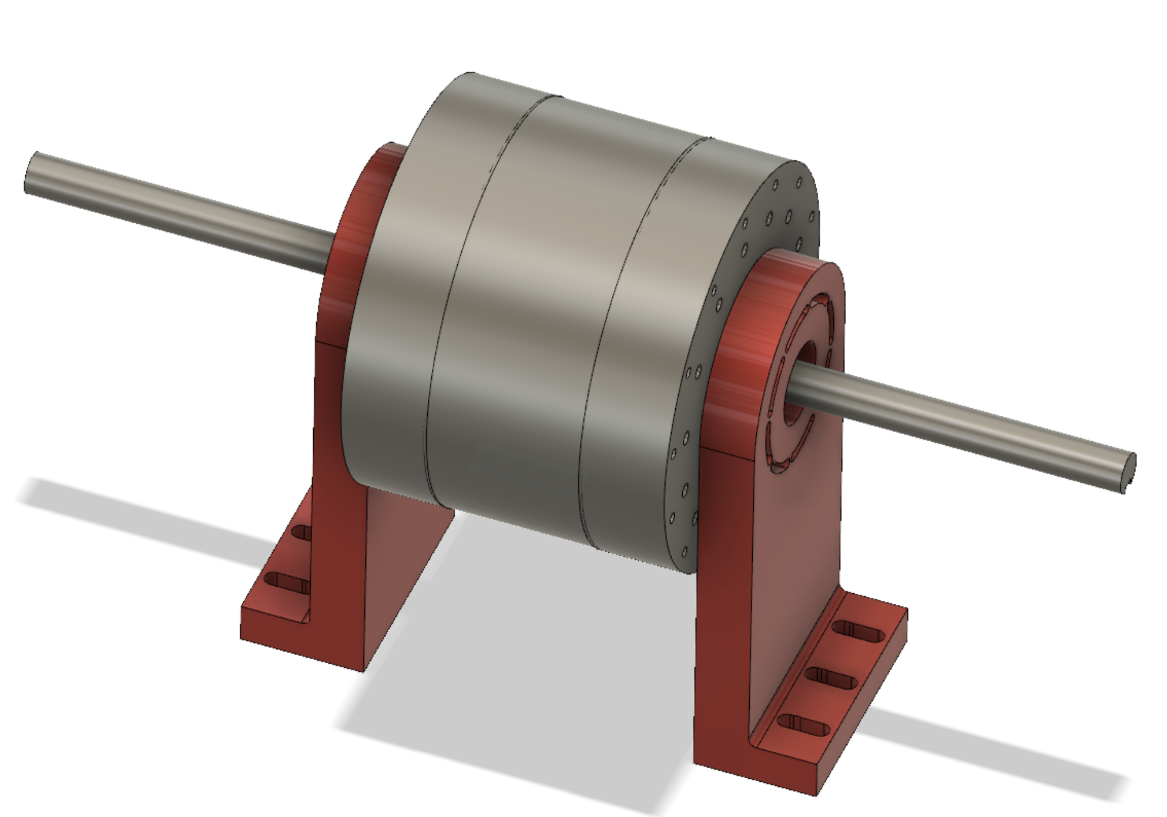
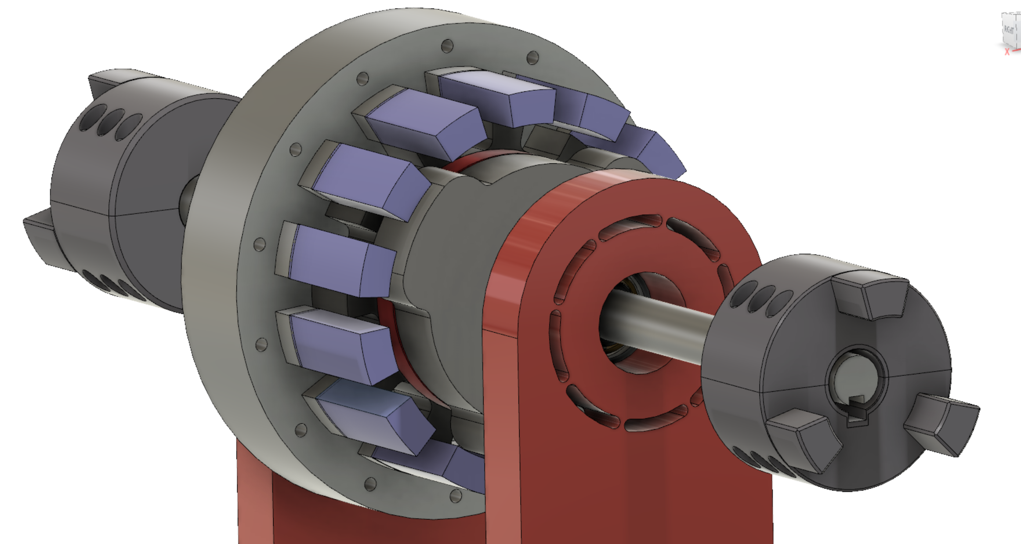
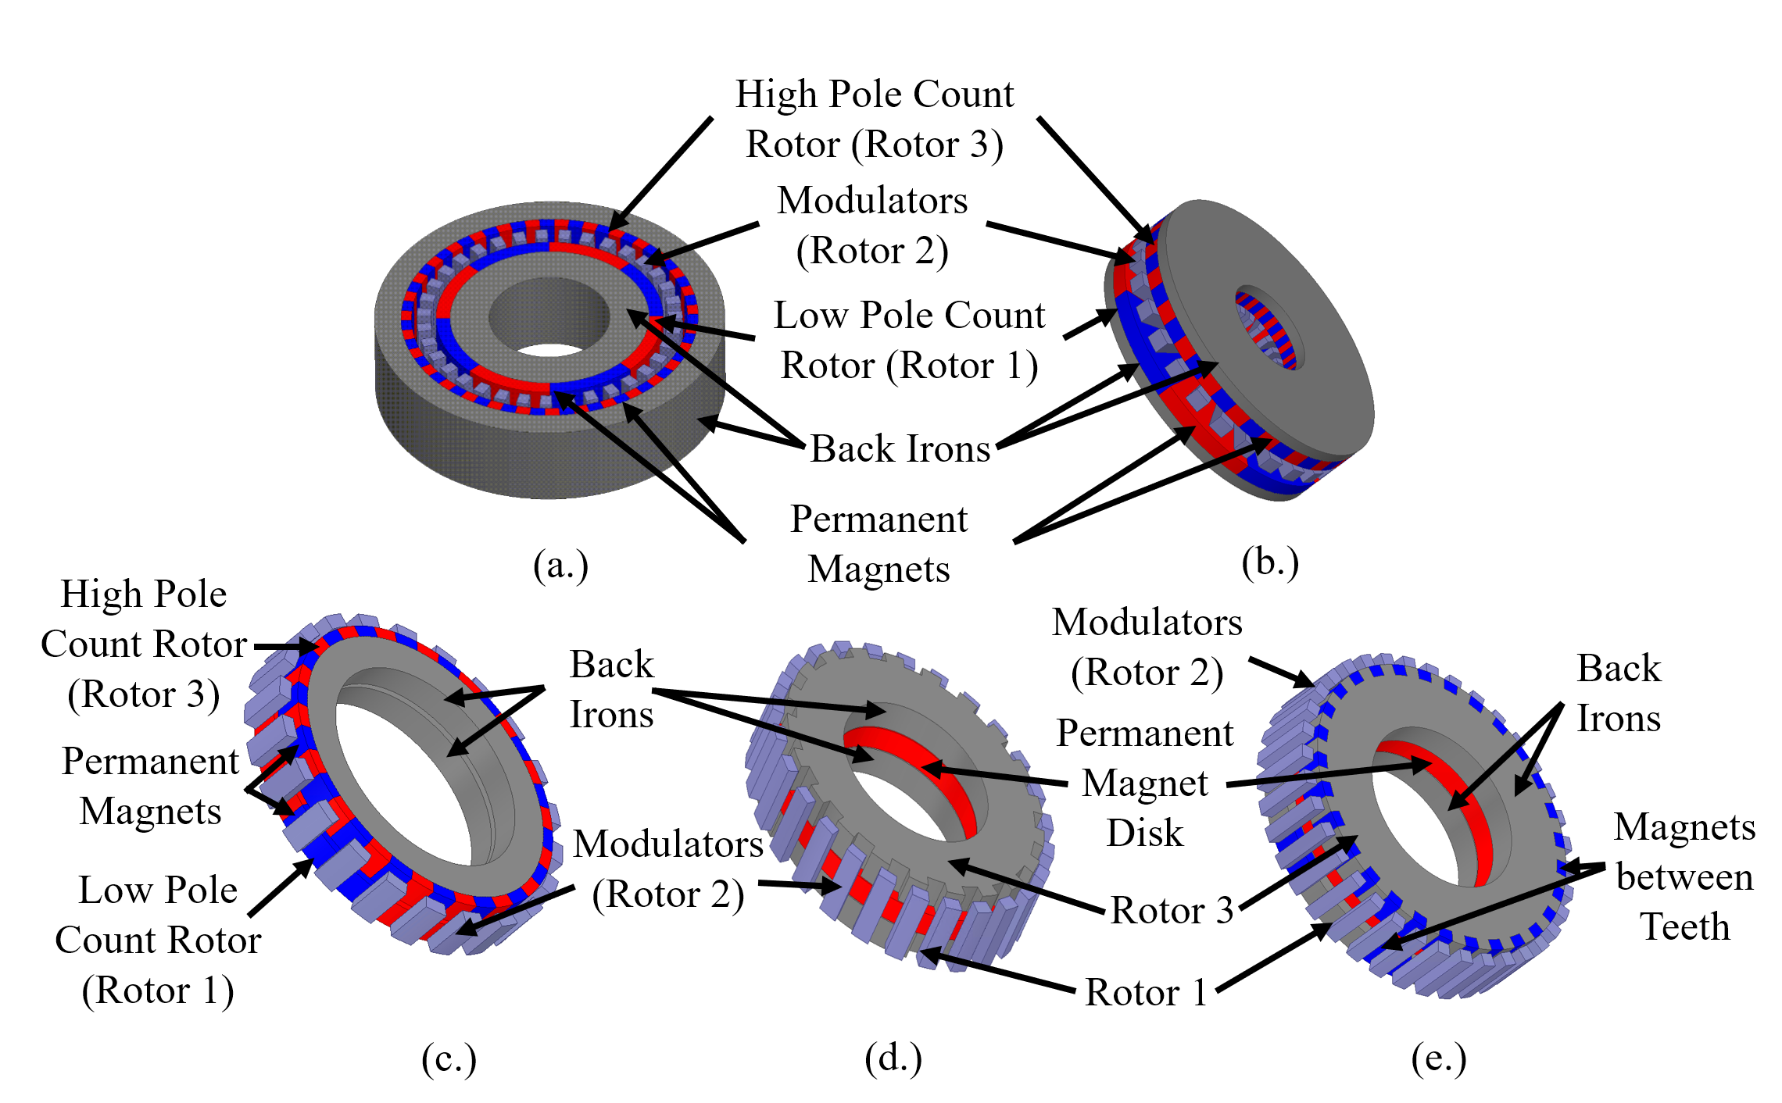
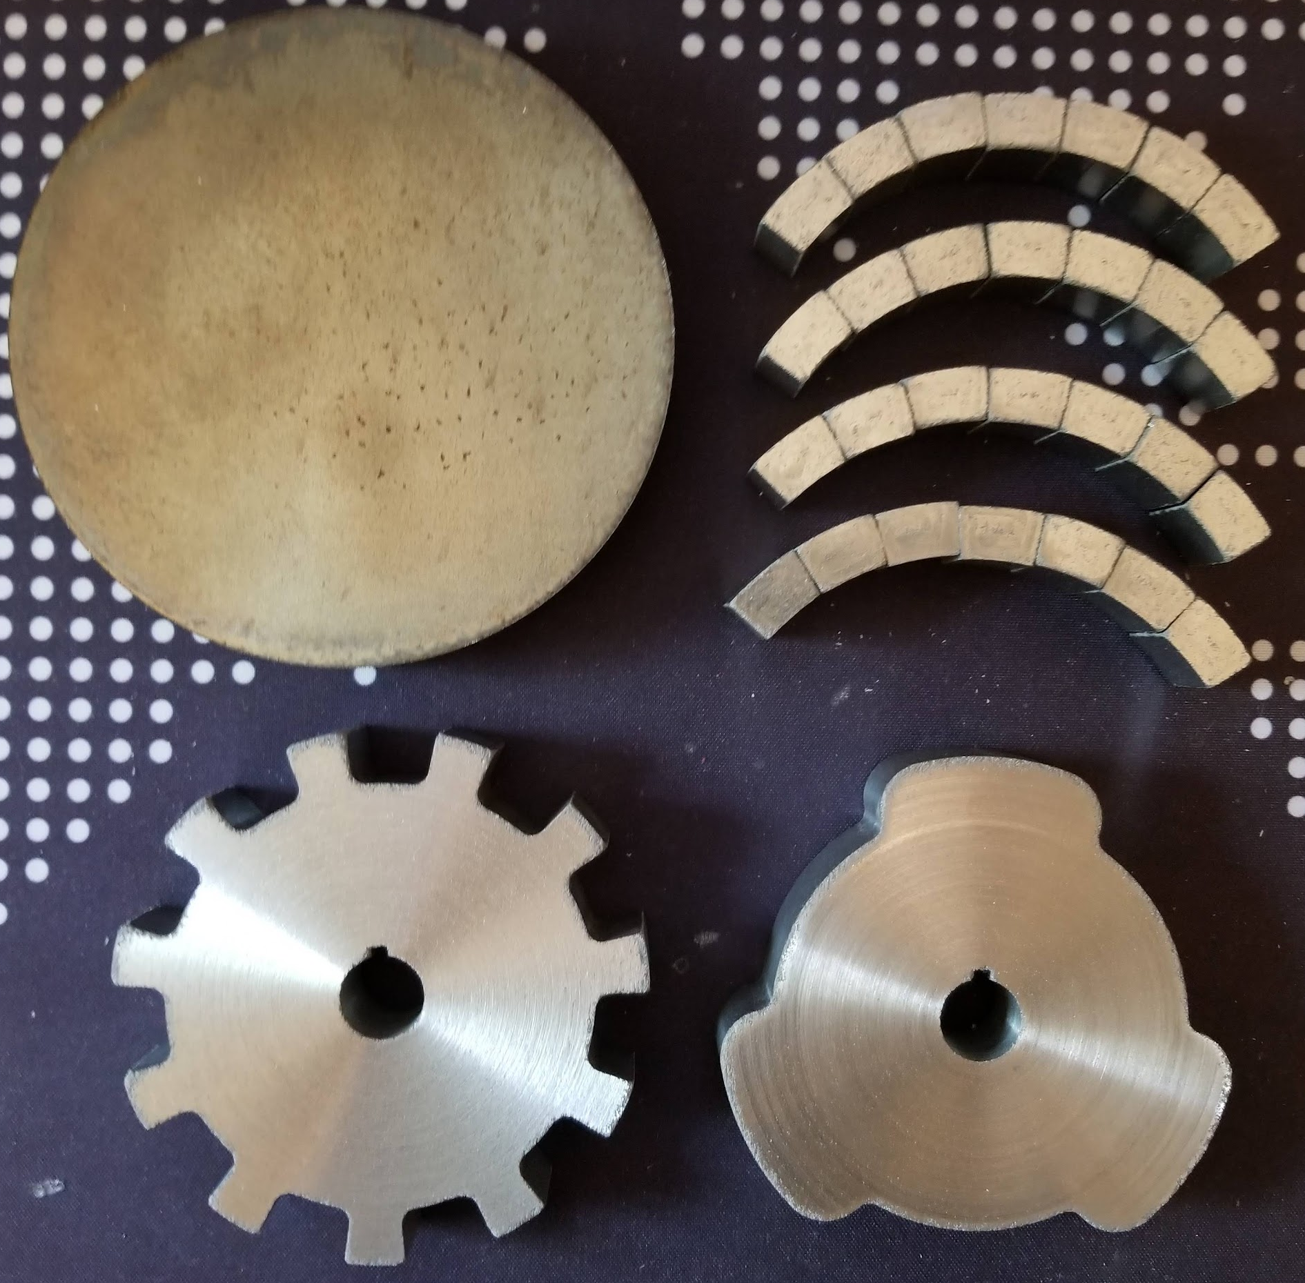
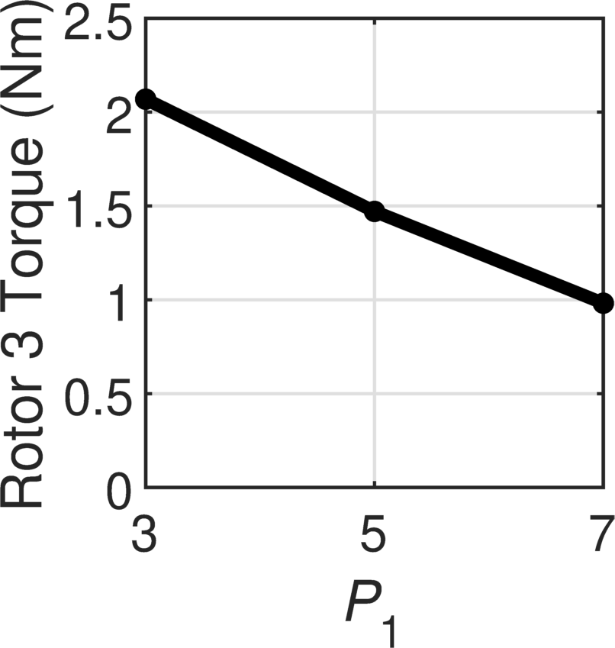
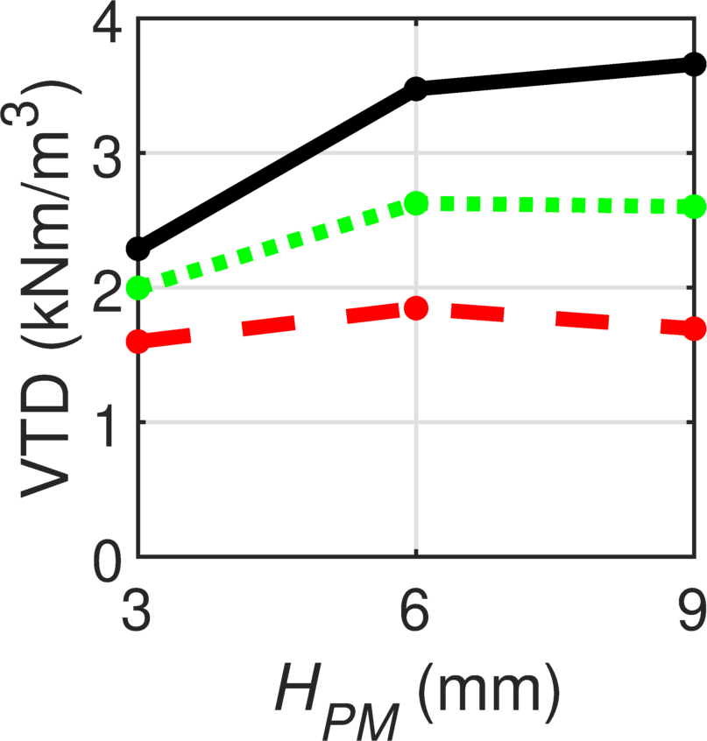
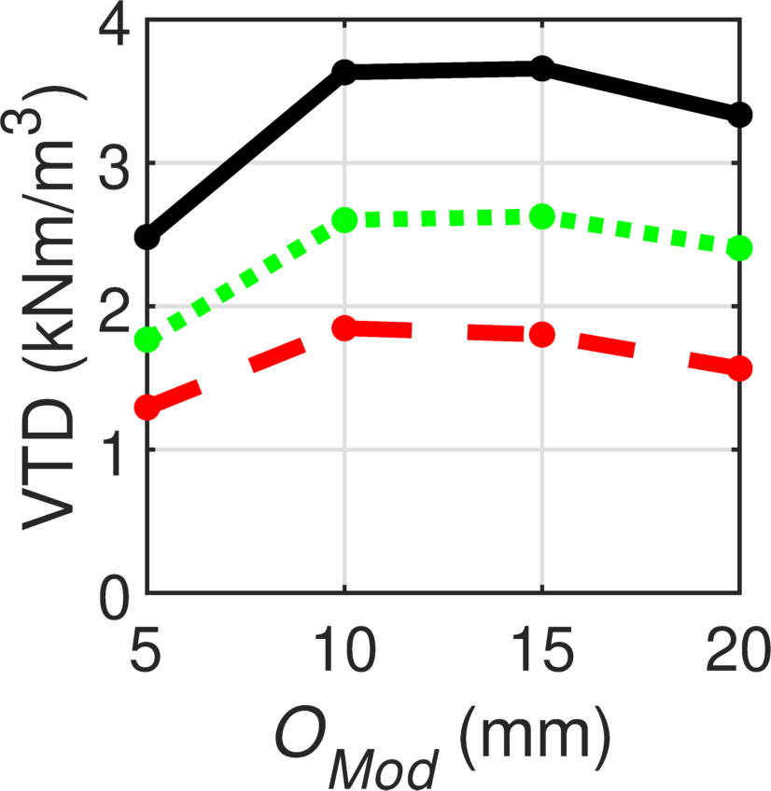
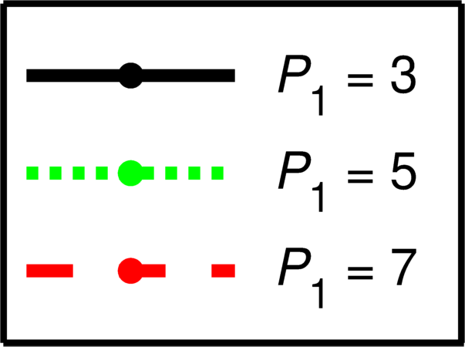
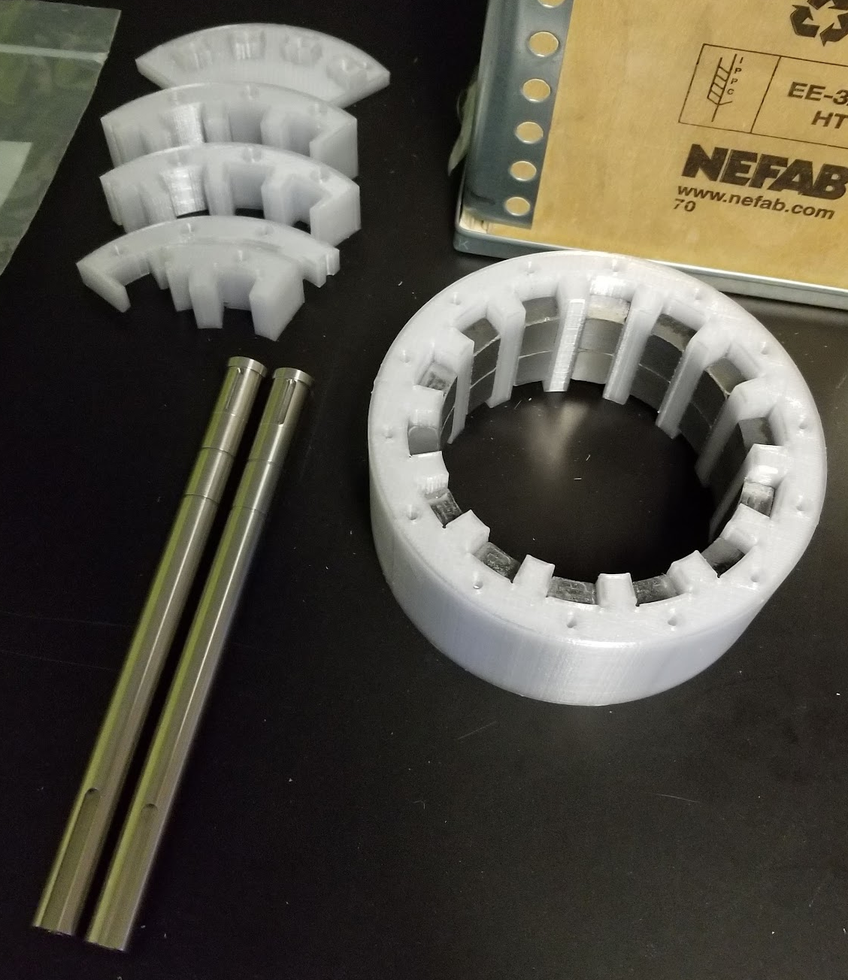
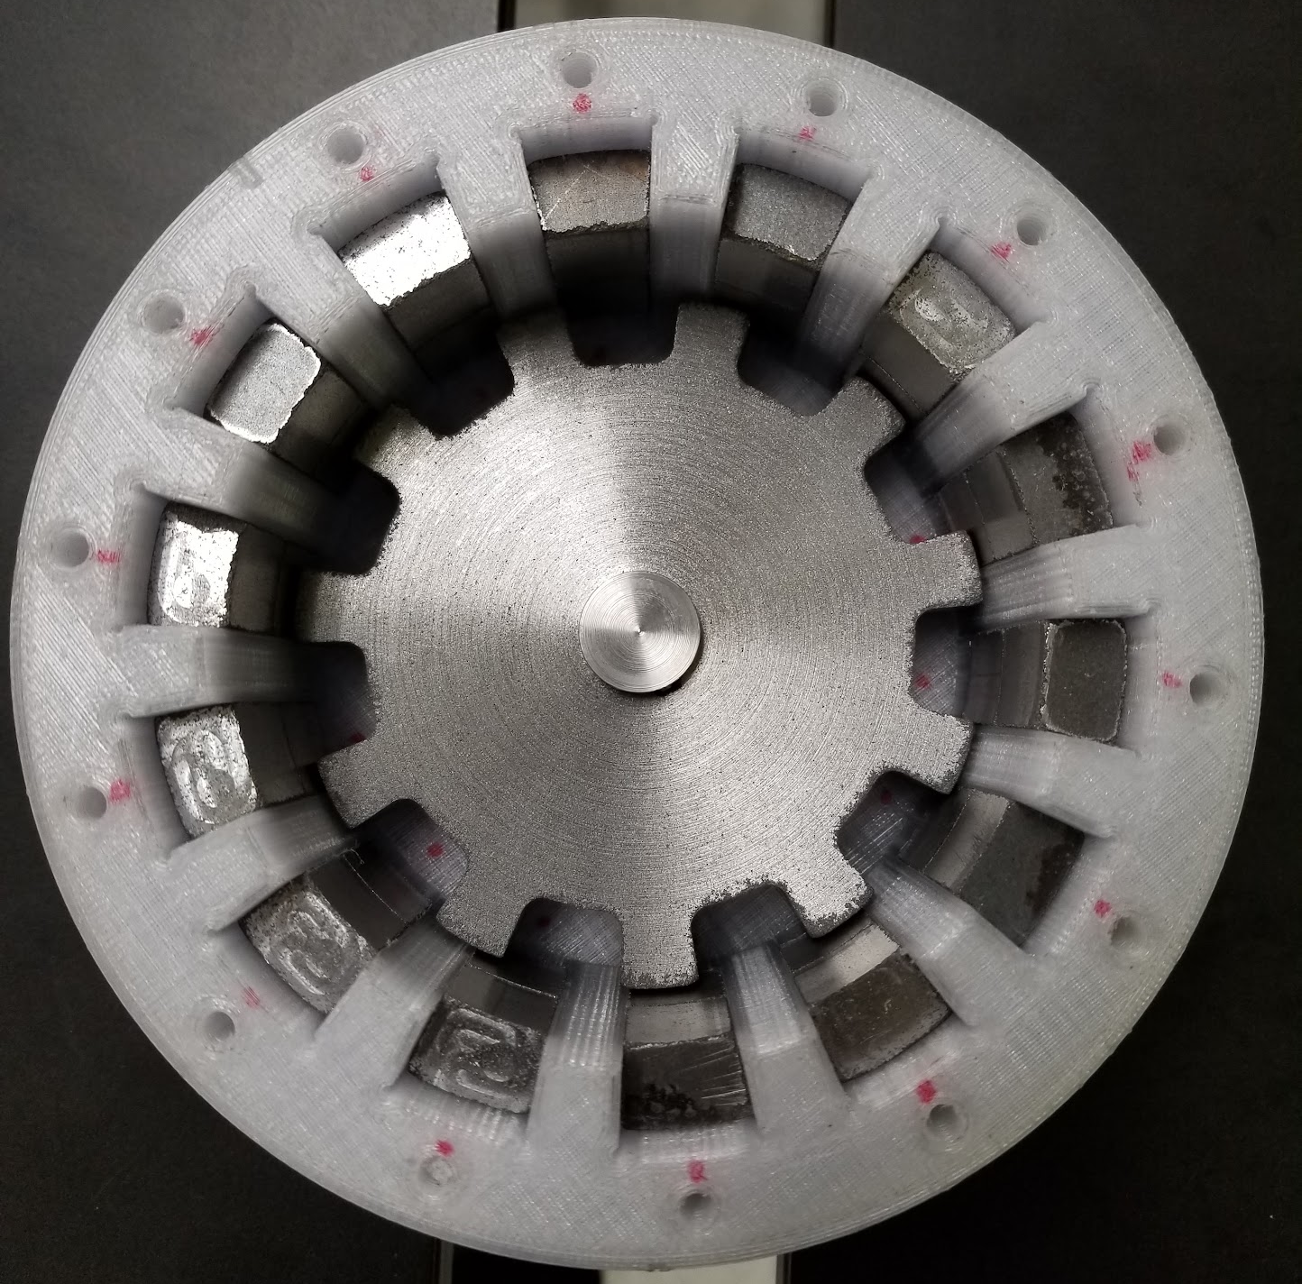
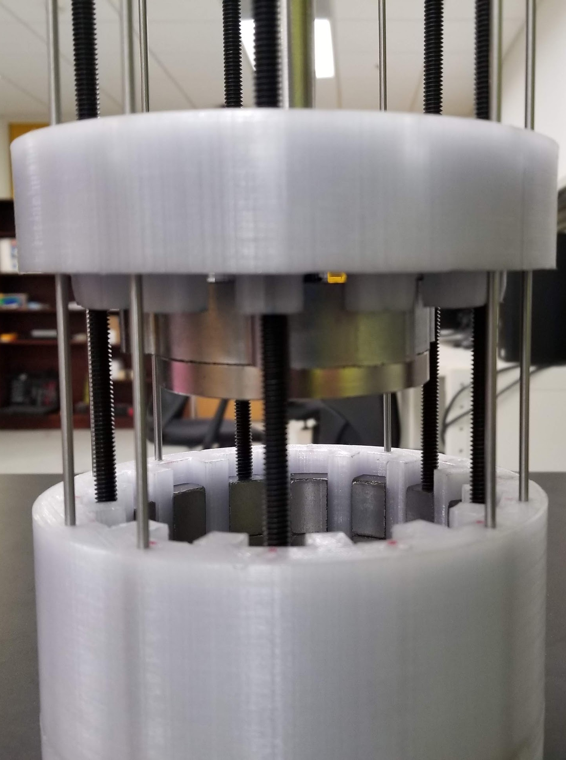
Development and Analysis of a Consequent Pole Transverse Magnetic Gear Salek Khan¹ ,Matthew C. Gardner¹ ¹Department of Electrical Engineering and Computer Science, University of Texas at Dallas
Electric Powertrains Laboratory
Introduction
Measured Results
Magnetic gears perform the same function as mechanical gears but rely on noncontact operation to transfer power
This non-contact lends itself to man potential benefits of magnetic gears over traditional mechanical gears:
Physical isolation between the shafts
Lower acoustic noise
Improved reliability
Increased efficiency
“Built-in” overload protection
There are a variety of different topologies of magnet gears that have been studied already, each of which have their own use cases (se Figure 1.) This project focused on developing completely new topology
Prototype Design and Assembly
The main metric that we measured was the slip torque reading of the gear
To make this measurement, we used the setup shown in Figure 6
In our simulations we predicted the gear should slip at around 1.63 Nm, this lined up closely with the numbers that we actually observed (shown in Figure 7)
The reason the slip torque on the high speed rotor (HSR) is much smaller than that on the low speed rotor (LSR) is because of the gear ratio. In our case the gear ratio is 3.67, so the HSR slips at approximately 3.67 times less torque than the LSR.
The main advantage of our new topology was ease of assembly
In other topologies, one of the most difficult parts of assembly is the magnet arrays
We solved this problem by making our topology only use one large disk magnet
Additionally, unlike other topologies, the modulators are not contained within the gear, rather they are suspended externally, which aids in manufacturing
After settling on design parameters from the simulations, a gear enclosure, end caps and input/output shafts were designed in CAD. The final model is shown in Figure 3.
Fig. 3: A picture of the assembled gear (left), a matching view of the Fusion 360 CAD model of the magnetic gear (middle), a screenshot of inner workings of the gear also in CAD
Fig. 6: A picture of the setup we used to measure the slip torque. There is a adjustable 2 output DC power supply (top left), and an mixed-signal oscilloscope (top right). In the bottom of the photo there are torque meters on either side of the gear (in blue) with 3D printed couplers on both the input and output shafts, and the magnetic gear assembly in the center.
The rotors and the modulators are made from 60mm diameter, 20mm thick Somaloy pucks, as shown in Figure 4.
Somaloy is a special soft magnetic composite material made of sintered powder and allows for good magnetic flux flow with low losses
Assembly was complicated by two main factors:
Firstly, to stop the magnetic flux from the powerful magnet interfering with the other parts, most of the gear had to be made of non-magnetic materials. We 3D printed most of the parts in PETG plastic, however for the steel shafts we used a variety of stainless steel that is non-magnetic. The screws/fasteners were small enough, so normal steel screws could be used
Secondly, the large Neodymium-Iron-Boron magnet, would create ~250lbs of pulling force towards the other rotor. So, to ensure that the gear was put together in a slow and controlled manner, long screws were used to slowly lower one side of the gear onto the other (See Figure 5)
 | Low Speed Rotor | High Speed Rotor
 | Torque (Nm) | Torque (Nm)
Forward (CCW) | 1.706 | -0.542
 | 1.714 | -0.586
 | 1.714 | -0.581
Reverse (CW) | -1.714 | 0.532
 | -1.722 | 0.498
 | -1.712 | 0.522
Fig. 1: (a)-(c) Topologies of magnetic gears that have been studied before, (d)-(e) proposed new topologies
Simulation(s)
Before fully designing the gear enclosure and other components in a traditional CAD software, the modulators, two rotors and magnet were created in a finite element analysis (FEA) program
11 different parameters of the gears were swept to balance the feasibility of creating a physical prototype with the performance of the gear. A sample of some of the data resulting from the simulations can be seen in Figure 2
Fig. 7: The measured slip torque in Newton meter for both the LSR and the HSR
Conclusion
Overall this project showed that the new topology of magnetic gear that we proposed can be manufactured in a more straightforward manner due to the fact that a single magnet is used.
Additionally, we found that the proposed topology has a low torque density, but since the gear itself has a small overall footprint it could have potential uses in applications where manufacturing cost is critical and torque output is not
Although the slip torque of the gear was not particularly high, this number can be tripled by simply adding magnets between the teeth of the gears (see Figure 1(e)).
Fig. 4: Raw Somaloy puck (top left), modulators (top right), high speed rotor (bottom left), low speed rotor (bottom right).
Acknowledgements
Fig. 2: Simulation results showing how the number of teeth on rotor 1 affect the slip torque of rotor 3 (left), how the thickness of the magnetic disk and the axial overlap of the modulators (and the number of teeth on rotor 1) affect the volumetric torque density of the gear (middle and right respectively).
I would like to give special thanks to Dr. Gardner for giving me the opportunity to conduct research in his lab and allowing me to pursue an RA position.
I would also like to thank Andrew Bittner from the UT Dallas machine shop for helping machine out and assemble the parts for this project.
Fig. 5: The two 304 stainless steel shafts, the modulators and the modulator “cage” (left), the high speed rotor installed (center left), lowering the halves of the main assembly (center right), the assembled gear (right)

