Slide 1
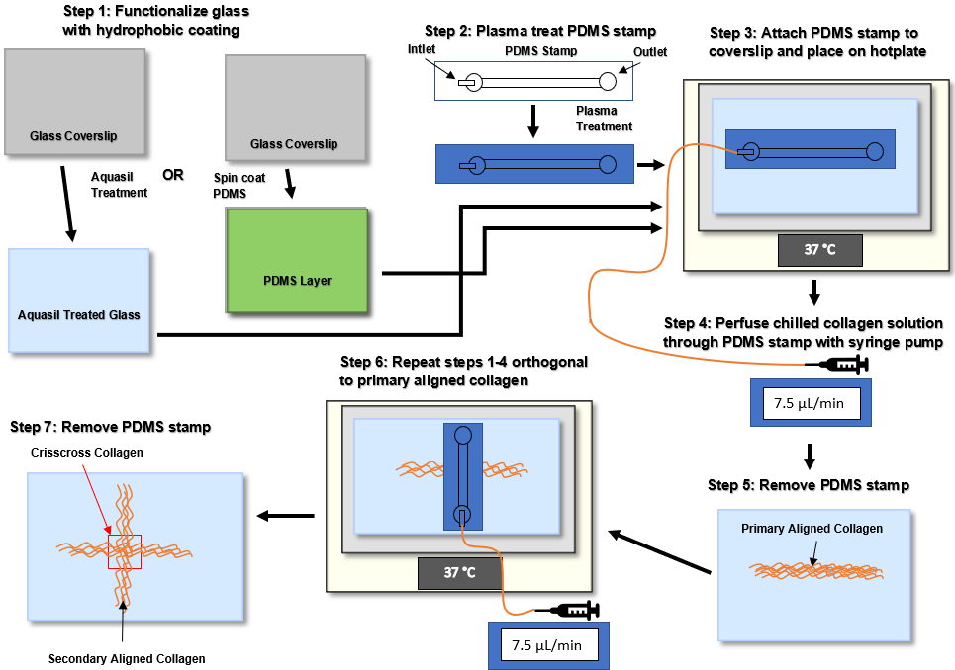
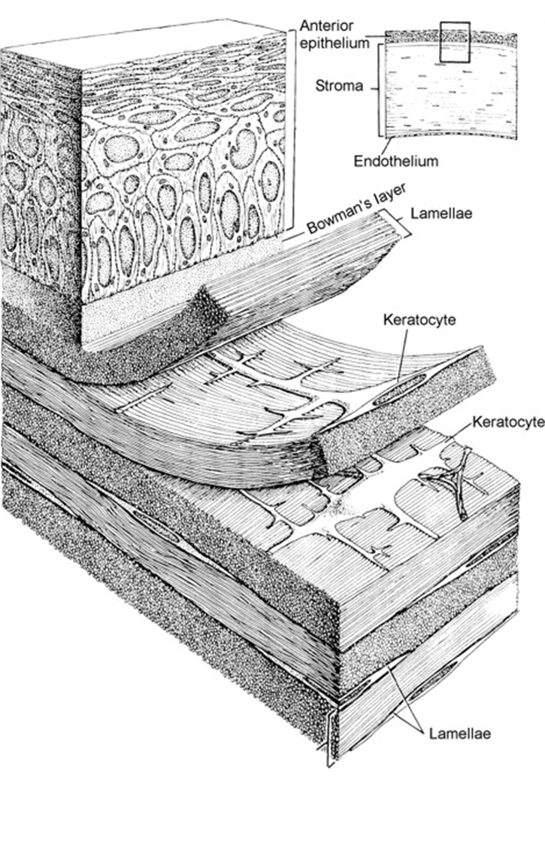
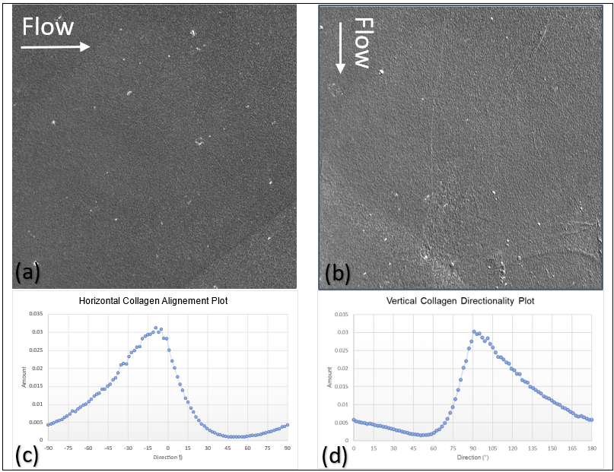
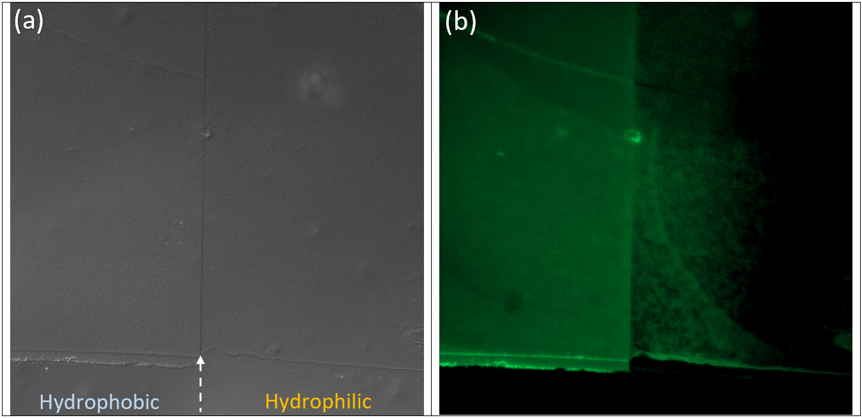
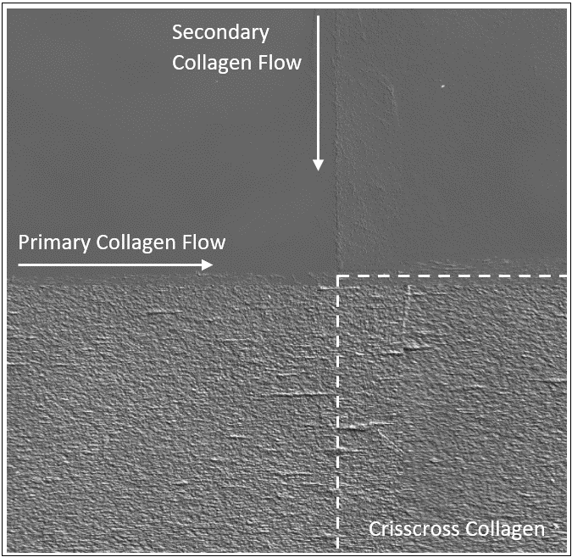
Fabrication of Crisscross Patterns of Aligned Collagen Fibrils to study Keratocyte Migration and Differentiation
Nathaniel Tjahjono¹, David Schmidtke¹
¹Department of Bioengineering, University of Texas at Dallas, 800 W. Campbell Tc, Richarcson, TX 75080, USA
INTRODUCTION
METHODS
CONCLUSION & FUTURE DIRECTION
The human cornea is composed of several layers, including most prominently the epithelium, Bowman’s layer, the stroma, and the endothelium. In comparison to all other components, the stroma, formed primarily of aligned collagen fibrils organized into hundreds of sheets known as lamellae, is by far the largest. One particularly interesting characteristic of the stroma is that the collagen lamellae are arranged orthogonally to each other in an interweaving crisscross pattern that allows light to pass through the cornea^{[1]}.
Previous literature on the topic suggests that this unique topography plays an important role in the wound healing process by influencing the behavior of the keratocytes that develop and maintain the stromal environment^{[2-3]}. Therefore, the fabrication of a model that mimics the structure and organization of the corneal stroma would greatly aid in shedding light on how keratocytes behave before, during, and after wound healing. This research project focuses on creating this topography by fabricating two orthogonally stacked layers of aligned collagen fibrils. Using a microfluidic approach, a region of crisscross collagen was successfully achieved. In future work on this project, keratocyte cells will be seeded and observed on these collagen substrates.
Fig. 2 Schematic of Aligned Collagen with Region of no Fibrils. A PDMS device is bonded to a PDMS coated slide and plasma treated to produce a hydrophilic region. Chilled collagen solution is then perfused orthogonal to the hydrophilic region. The PDMS device is removed, and the collagen is rinsed and left to dry.
At the current point in this project, the fabrication of crisscross patterns of aligned collagen fibrils is reproducible. However, the rip-off of the primary collagen fibrils with the second PDMS device remains inconsistent across experimental trials. Therefore, the future direction of this project consists of two parts: resolving the rip-off reproducibility of the crisscross collagen and seeding and observing keratocytes on crisscross collagen. While the latter of these objectives is relatively straightforward, there are a multitude of factors contributing to the collagen’s rip-off that complicate the former objective. A few of these factors that have been considered throughout the course of this project include the following:
Time between primary and secondary collagen fibril perfusion
Substrate surface hydrophobicity
PDMS device age
PDMS device removal technique
Collagen fibril hydration at the time of PDMS device removal
The inconsistency with collagen rip-off during crisscross collagen fabrication is likely due to a combination of these and other factors. As such, completion of a protocol that produces crisscross collagen with consistent rip-off or no rip-off will need to be achieved by controlling all variables or by another approach. The hydrophilic approach that was tested during this project shows promise for consistently fabricating collagen fibrils with a tear-off region that can be utilized to make a patch of crisscross collagen of known dimensions. Once a consistent protocol has been created, keratocytes can be seeded on the resulting substrates and observed to learn more about their behavior in the mimetic environment.
Fig. 2 Schematic of Crisscross Aligned Collagen Fibril Formation via Microfluidic Deposition. Adapted from previous lab group protocol^{[4]}. A polydimethylsiloxane (PDMS) microfluidic device is plasma treated and bonded to a treated glass coverslip. The assembly is placed on a hotplate and chilled collagen solution is perfused through the device and polymerizes on the glass coverslip’s hydrophobic surface. After perfusion, the device is removed and the polymerized collagen fibrils are rinsed and left to dry. A second PDMS device is bonded to the coverslip orthogonally over the first collagen line and placed on the hotplate. Chilled collagen solution is again perfused through the device. After secondary perfusion, the device is removed, and the collagen is rinsed and left to dry.
Fig. 1 Organization of Stromal Lamellae within the Cornea^{[1]}.
RESULTS
Fig. 4 Microfluidic methods produced a crisscross collagen region with dimensions of 1500 μm x 1500 μm. DIC imaging was used to stitch several 20x images to display the entire crisscross collagen region of a substrate. The collagen perfused horizontally in this sample was the first layer deposited, so that when the PDMS device was removed following the vertical perfusion, the fibrils to the left and right of the crisscross region were torn off. However, in the samples produced via this experiment, the extent off tear-off observed on either side varied widely, making this aspect of the crisscross collagen inconclusive and inconsistent.
REFERENCES
Ehlers, N., Hjortdal, J. (2005). The Cornea: Epithelium and Stroma. Advances in Organ Biology, 10(3), 83-111. https://doi.org/10.1016/S1569-2590(05)10003-2.
Yam, G. H. F., Riau, A. K., Funderburgh, M. L., Mehta, J. S., & Jhanji, V. (2020). Keratocyte biology. Experimental Eye Research, 196(March), 108062. https://doi.org/10.1016/j.exer.2020.108062
3. Komai, Y., & Ushiki, T. (1991). The three-dimensional organization of collagen fibrils in the human cornea and sclera. Investigative Ophthalmology and Visual Science, 32(8), 2244–2258.
4. Lam, K. H., Kivanany, P. B., Grose, K., Yonet-Tanyeri, N., Alsmadi, N., Varner, V. D., Petroll, W. M., & Schmidtke, D. W. (2019). A high-throughput microfluidic method for fabricating aligned collagen fibrils to study Keratocyte behavior. Biomedical Microdevices, 21(4). https://doi.org/10.1007/s10544-019-0436-3
OBJECTIVES
Fig. 3 Directionality analysis of collagen fibrils demonstrate their alignment along the horizontal and vertical axes. Differential interference Contrast (DIC) images of the collagen lines (a-b) used to form a crisscross pattern were taken and analyzed in ImageJ to produce directionality histograms that indicate collagen alignment along (c) the horizonal axis (0°) and (d) vertical axis (90°).
Fabricate crisscross collagen patterns
Analyze collagen to verify alignment
Determine factors contributing to collagen rip-off
Try alternate microfluidic methods for consistent collagen rip-off
Seed keratocytes on crisscross collagen and observe their behavior
Fig. 5 Corner of Fabricated Crisscross Collagen Exhibits Aligned Collagen Fibril Layer Overlapping. DIC imaging of the crisscross junction at 20x displays two distinguishable lines of aligned collagen fibrils. Since the image is taken from the bottom side of the substrate, the primary collagen line, as expected, is overlapped on the back side by the secondary collagen line.
ACKNOWLEDGEMENTS
This research is supported by the Jonsson School‘s Undergraduate Research Award program.
I would also like to thank Dr. Schmidtke and the Schmidtke lab group for their immense support and mentorship throughout this project.
Fig. 6 Hydrophilic Patch Experiment Produced a Cut-off Region with Less Collagen Polymerization. DIC (a) and fluorescent (b) imaging of the experiment's substrate stained with DTAF (5-(4,6-dichlorotriazinyl) aminofluorescein) demonstrates in (b) a distinct decrease in intensity on the hydrophilic vs hydrophobic surface, indicating a decrease in collagen fibrils.

