Slide 1
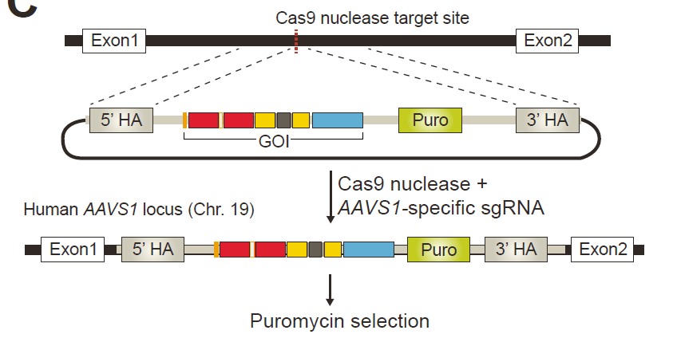
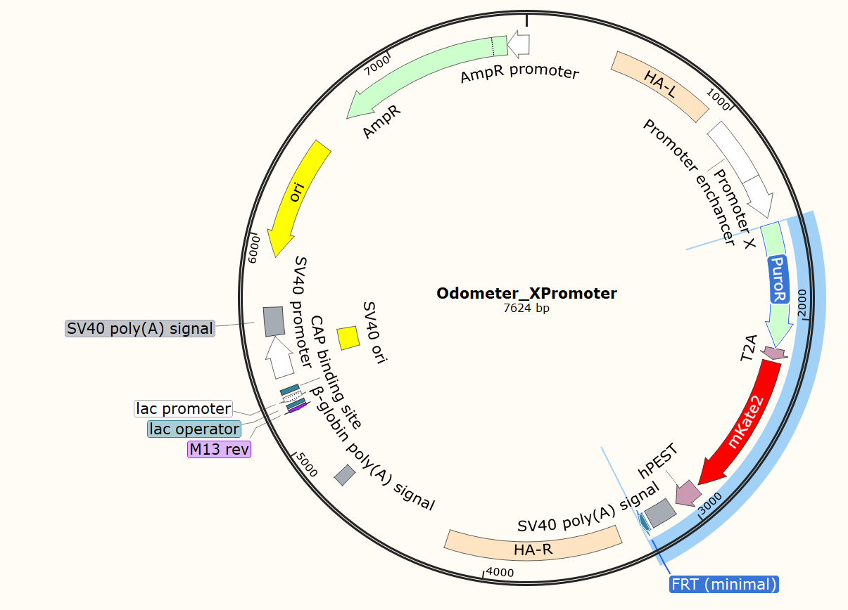
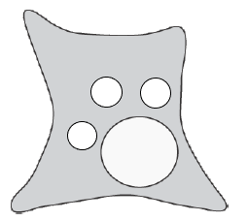
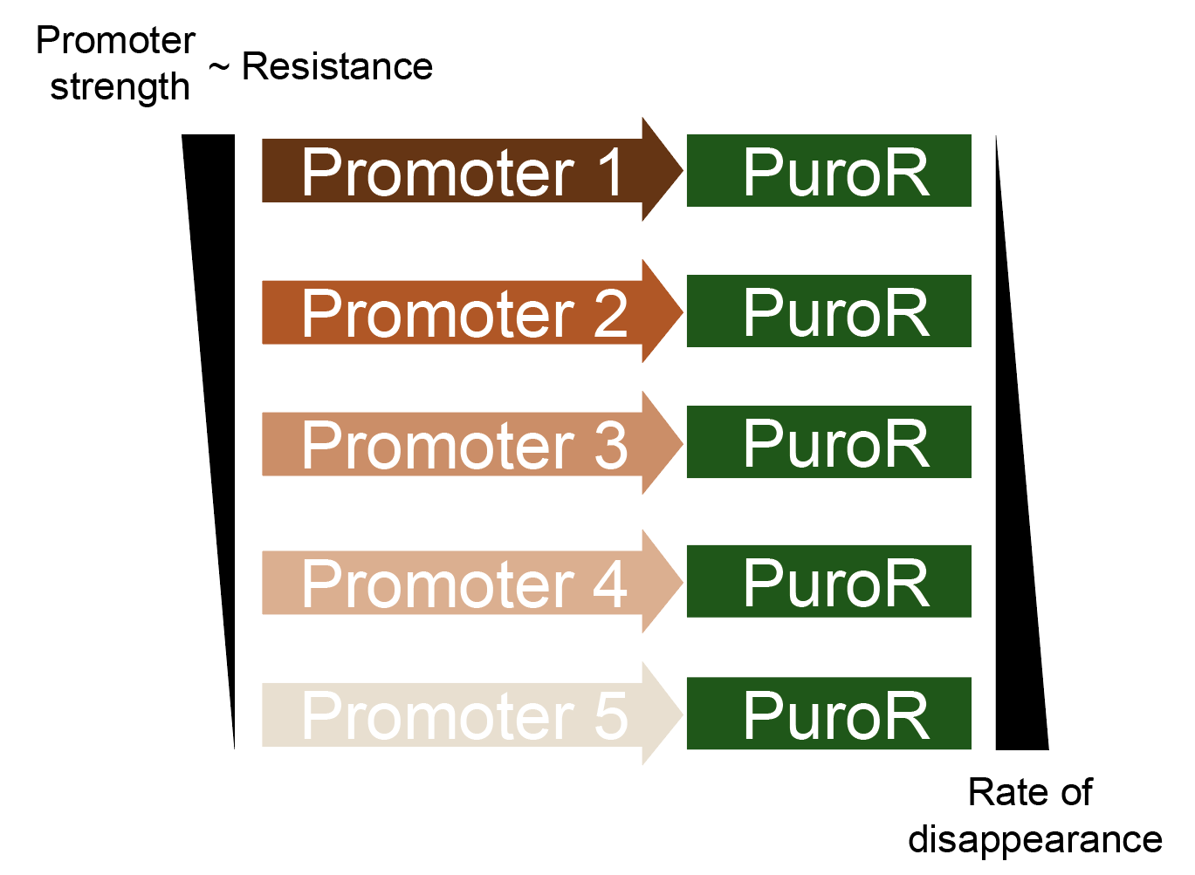
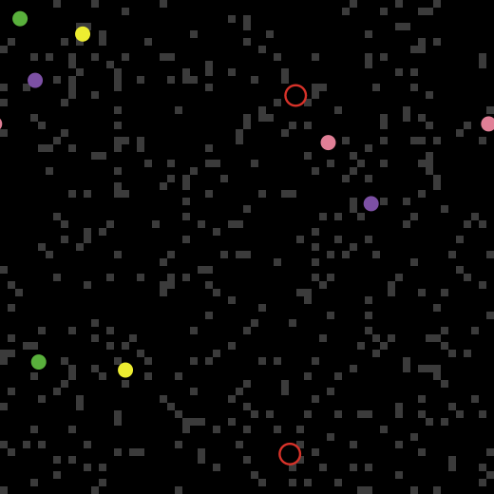
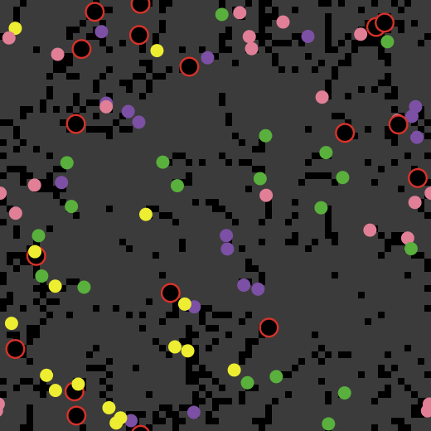
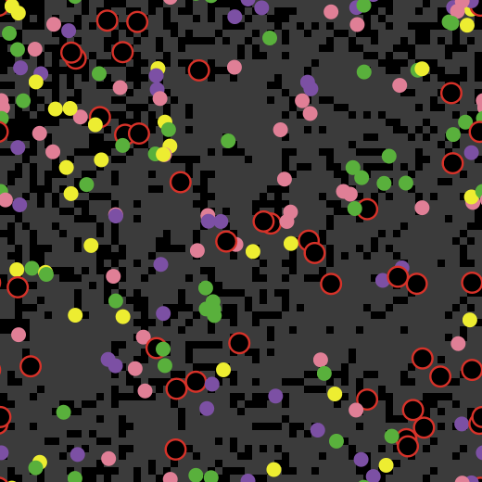
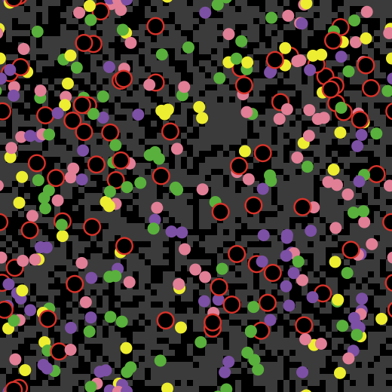
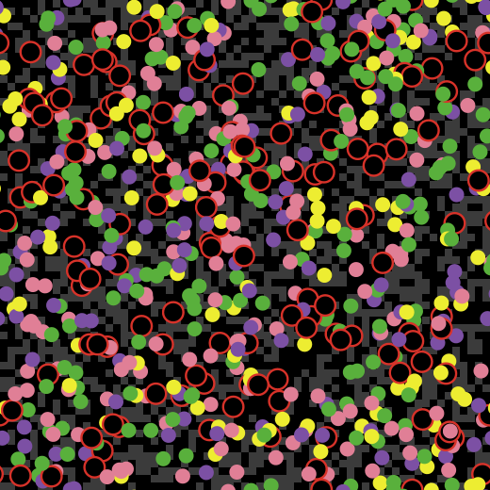
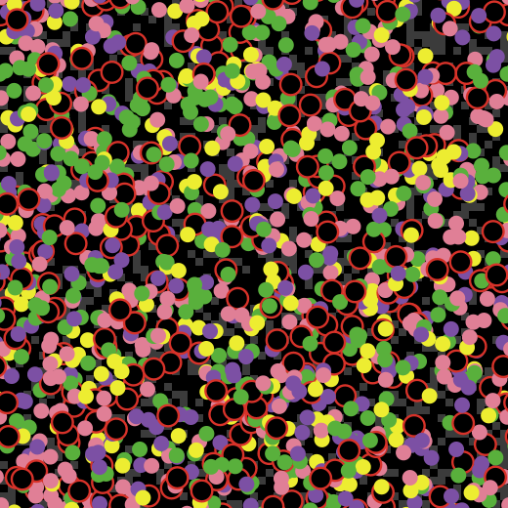
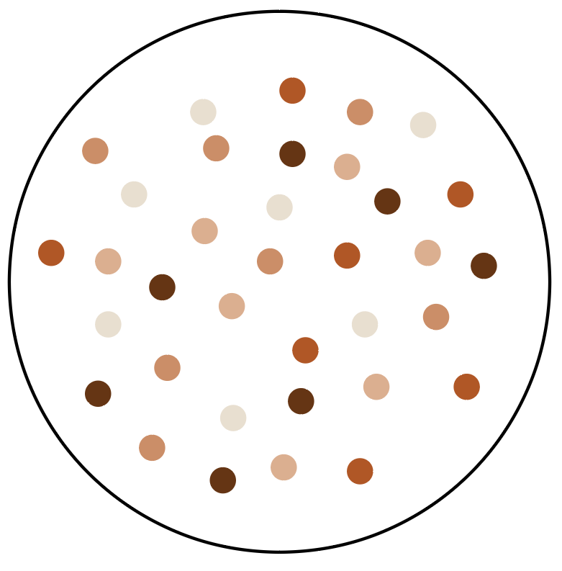
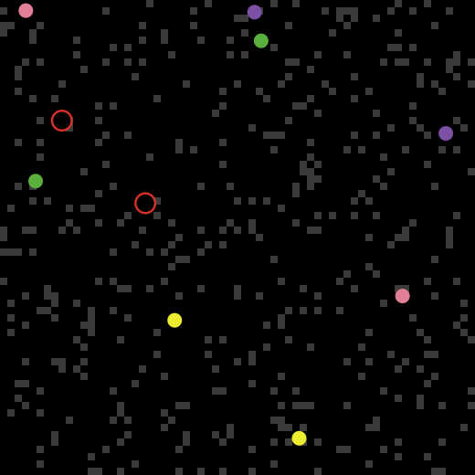
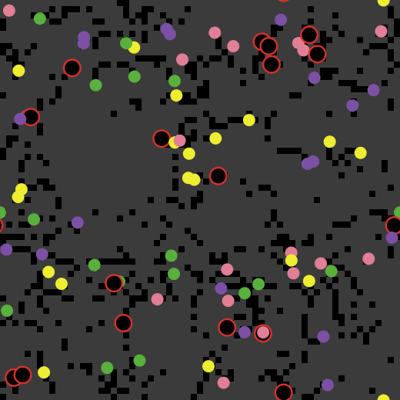
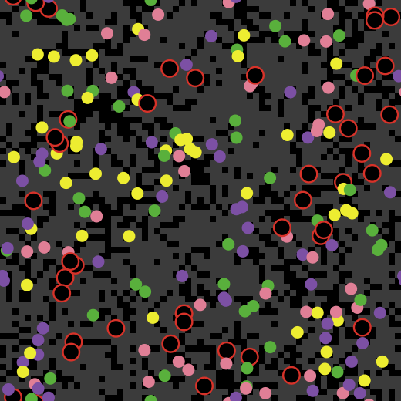
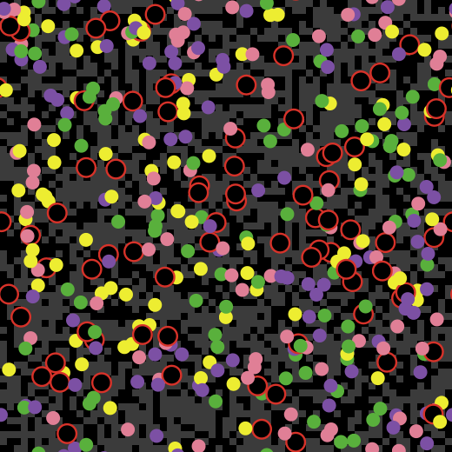
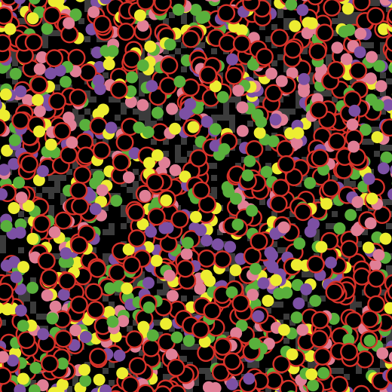
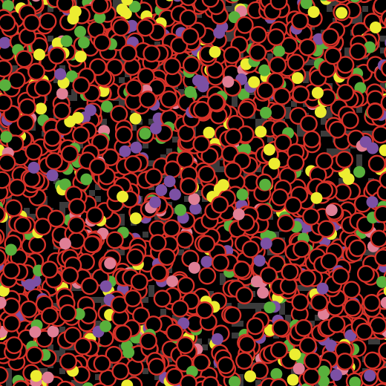
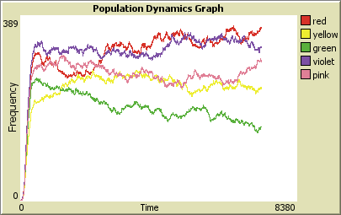
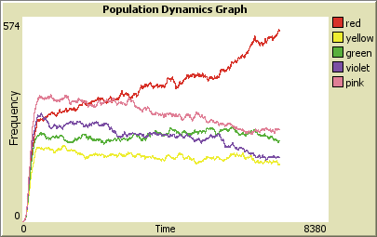
Tracking cultured cell growth time using synthetic gene circuits
John Nguyen, Taek Kang and Leonidas Bleris*
Department of Bioengineering, Bleris Lab, The University of Texas at Dallas
Background
Methods and Procedures
Supplementary Information
Cultured cell lines such as kidney embryonic cells (HEK293) play a significant role in biomedical studies as they are commonly used as models for disease and cell function. These cell lines will grow indefinitely in vitro if the space and nutrients requirements are available. If left unsupervised, they will continue to reproduce until they use up the available nutrients and die. To prevent this, they must be sub-cultured at a lower confluency. Prolonged maintenance of cell cultures (over 2 months) results to unwanted side effects such as reduced proliferation rates and accumulation of mutations that can impact their phenotype ^{[1]}. Therefore, it is crucial to keep track of how long a cell line has been maintained.
Experimental Procedures
Goal: Build cell lines with puromycin resistance with 5 different promoters at varying strengths. Plasmids containing the 5 different promoters and puromycin resistance will be constructed and integrated into HEK293 cells via Cas9-mediated homogenous recombination.
Steps:
Replace gene of interest [“enzyme1” – “enzyme2” – puro – T2A – mKate2].
Remove segment from D11 with AsiSI and SalI digestion.
Obtain insert:
From FCD 115 template
Add enzyme sites “enzyme1” – “enzyme2” using PCR primer overhang
5’ overhang AsiSI
3’ overhang SalI
PCR and Gel Purify
Ligate insert with homologous arms of D11 segment.
Transform NEB 5-alpha Competent E. coli cells.
Inoculate and Mini-Prep; No Promoter template.
Digest No Promoter template with AsiSI and MluI
Ligate with promoters (CMV, EF1a, SV40, PGK, UbC)
Transform NEB 5-alpha Competent E. coli cells.
Inoculate and Mini-Prep; final plasmids.
Integrate final plasmids into HEK293 cells using CRISPR/Cas9 technology.
Objectives
AAVS1 safe-harbor locus integration mechanism ^{[2].}
Implement a cellular “odometer” which will allow for the measurement of elapsed time for a cell culture that has been growing.
Generate synthetic gene circuits and integrate them in HEK293 genome using CRISR/Cas9 ^{[2]}. These synthetic gene circuits will utilize 5 promoters of varying strengths; CMV > EF1a > SV40 > PGK > UbC ^{[3]}.
These custom genome modified cell lines will be maintained under controlled media conditions to serve as a method to keep track of the cell culture age.
Characterize these circuits under a range of cellular conditions to correlate cellular aging with the circuit output.
Integrate with CRISPR/Cas9
HEK293 Cells
Integrated HEK293 Cells
Promoter replacement plasmid template with genes of interest (highlighted region).
Conclusion
Expected Results
A cellular odometer that utilizes engineered cell lines will serve as a method of tracking the amount of time that has elapsed since the cell culture commenced. This method of tracking will serve as an alternative to manual tracking to monitor prolonged maintenance of cell cultures to minimize unwanted side effects such as reduced proliferation rates and accumulation of mutations that can affect their phenotype.
A growth simulation of the 5 co-cultured cell lines with varying promoter strengths over the course of 5 days can be seen above.
The promoter strengths from strongest to weakest are as follows; CMV (red), EF1a (pink), SV40 (yellow), PGK (green), and UbC (violet) ^{[3]}.
A comparison of the co-cultured cell lines grown without and with the addition of puromycin (at Day 0)*.
Day 0
Day 1
Day 2
Day 3
Day 4
Day 5
Future Work
No Puromycin Added
Establish the 5 different cell lines.
Co-culture the cell lines.
Correlate circuit output to cellular aging.
*
References
[1] American Type Culture Collaction, “Technical Bulletin No 7: Passage Number Effects In Cell Lines,” p. 3, 2010.
[2] T. Kang et al., “Robust Filtering and Noise Suppression in Intragenic miRNA-Mediated Host Regulation,” iScience, vol. 23, no. 10, 2020.
[3] J. Y. Qin et al., “Systematic comparison of constitutive promoters and the doxycycline-inducible promoter,” PLoS One, vol. 5, no. 5, pp. 3–6, 2010, doi: 10.1371/journal.pone.0010611.
Puromycin
Added
No Puromycin Added
Puromycin
Added
Acknowledgements
Co-culture of 5 cell lines with varying
resistance to puromycin
I would like to thank Dr. Bleris for giving me the opportunity to participate on this project as a part of his research team. I would also like to thank Taek Kang for teaching and guiding me through the course of this project.

