Slide 1
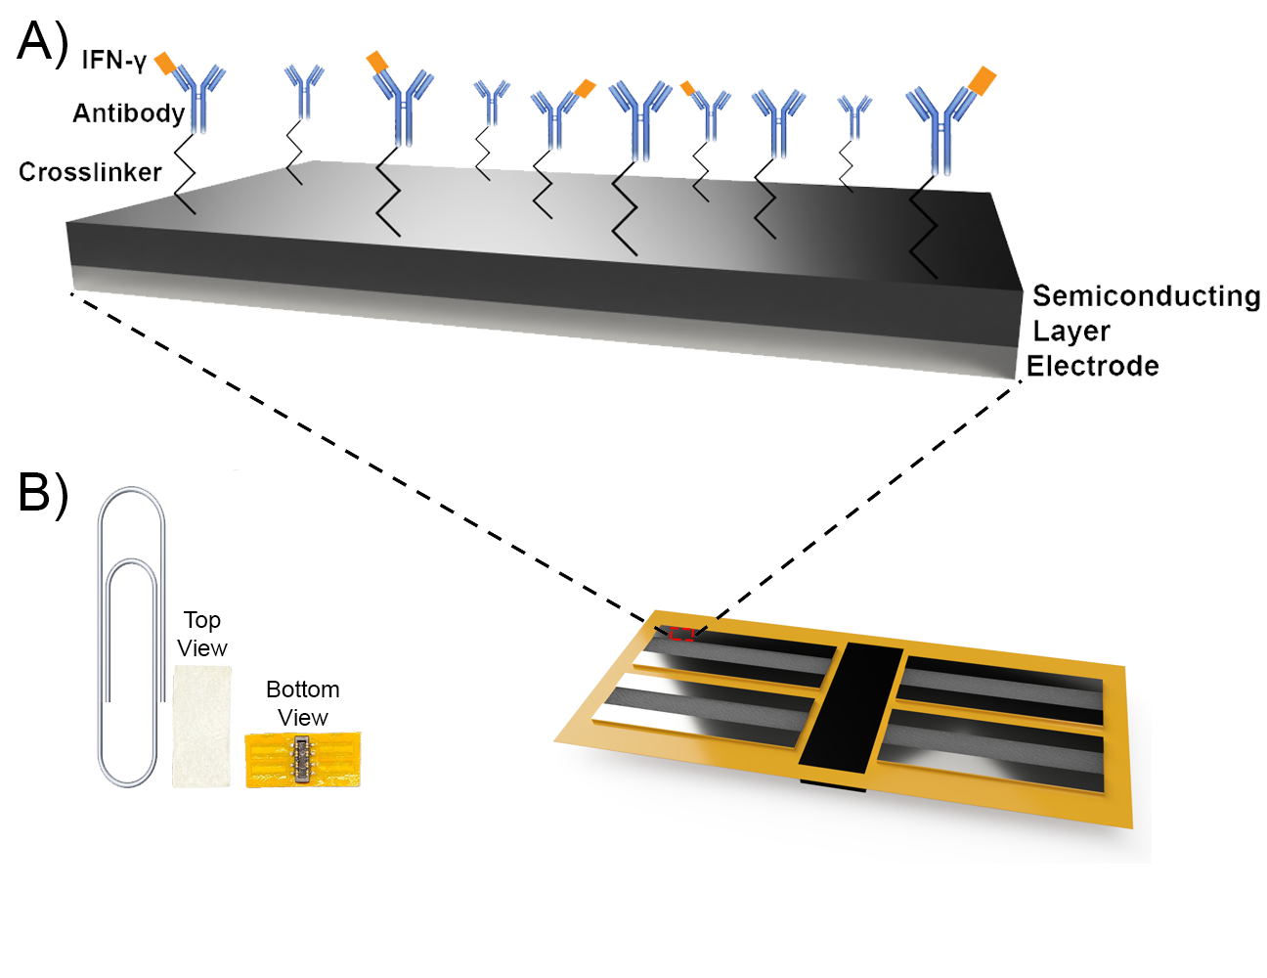
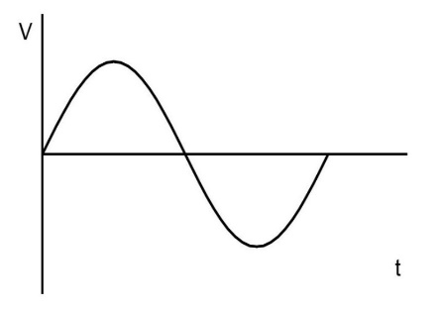
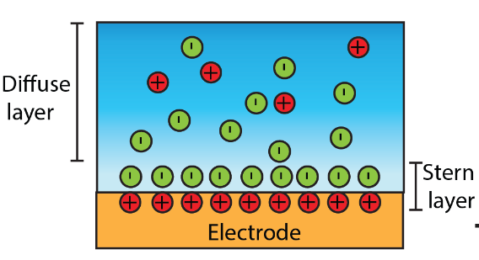
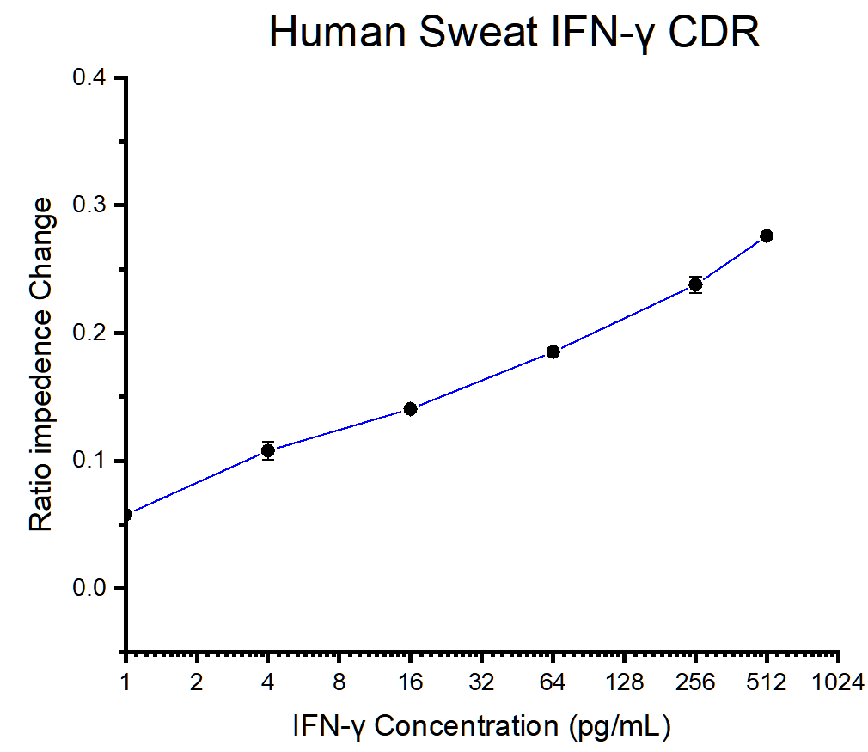
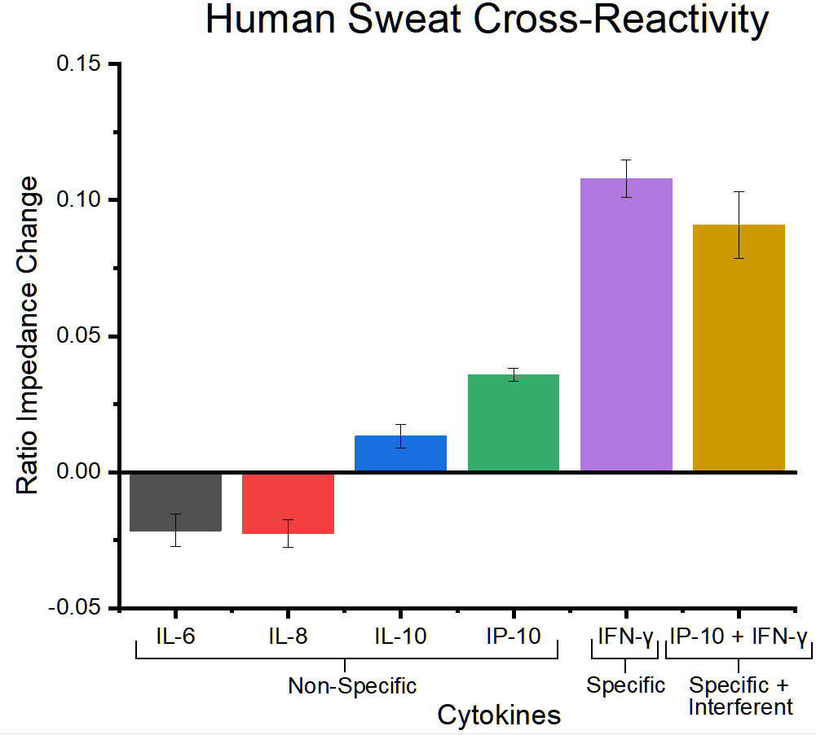
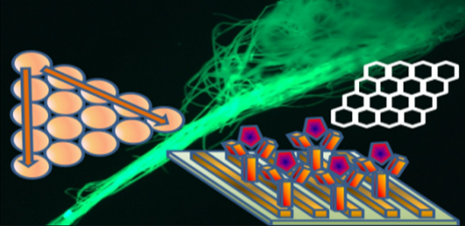
Biosensor for Monitoring of IFN-γ in Eccrine Sweat
Aashay Kothari¹, Badrinath Jagannath¹, Sriram Muthukumar², Shalini Prasad¹
The University of Texas at Dallas, Richardson, TX, 75080
EnLiSense LLC, Allen, TX 75013
INTRODUCTION
MATERIALS & METHODS
CONCLUSIONS & FUTURE WORK
Like serum, sweat contains various Inflammatory molecules that function as useful biomarkers for assessing body’s physiological state.
IFN-γ is a critical biomarker found in abundance during various types of bacterial/viral infections and during tumor/cancer growth.
A stable electrochemical sensor is imperative for the accurate and precise detection of IFN-γ in sweat.
Proof-of-feasibility of a sensing apparatus in the detection of IFN-γ in sweat.
Developed sweat sensor can detect a wide spectrum of IFN-γ levels found in healthy and sick individuals.
Future work will focus on real-time, continuous monitoring of IFN-γ concentrations in healthy and sick subjects.
Sweat IFN-γ levels will be correlated with serum levels to better understand sweat cytokine expression.
OBJECTIVES & INNOVATION
REFERENCES
Rapid and reliable IFN-γ sensing in sweat through a novel sensor
Jagannath et al., Analytica Chimica Acta (2018): 1016, 29-39
Jagannath et al., Bioengineering & Translational Medicine (2021): 10220
Dai et al., Plos One (2013): 67666
Jorgovanovic et al., Biomarker Research 8 (2020): 49
Sinusoidal Input Voltage
Detection of IFN-γ at low concentrations while avoiding interference from similar biomolecules
$$Z= \frac{V(t)}{I\left(t\right)}= \frac{V_{0}sin⁡(2πft)}{I_{0}sin⁡(2πft+φ)}$$
RESULTS
Sensor Metrics
Sensitivity
Limit of detection
Specificity
Dynamic range
ACKNOWLEDGMENTS
Sensor Metrics | Sweat (pg/mL)
Limit of Detection | 1
Dynamic Range | 1-512
Inference:
Both accurate and precise detection of IFN-γ at concentrations as low as 1 pg/mL and as high as 512 pg/mL with high sensitivity.
Specific detection of IFN-γ only, even in the presence of high concentrations of similar extraneous molecules found inherently in sweat.
Biomedical Microdevices and Nanotechnology Laboratory

