Slide 1
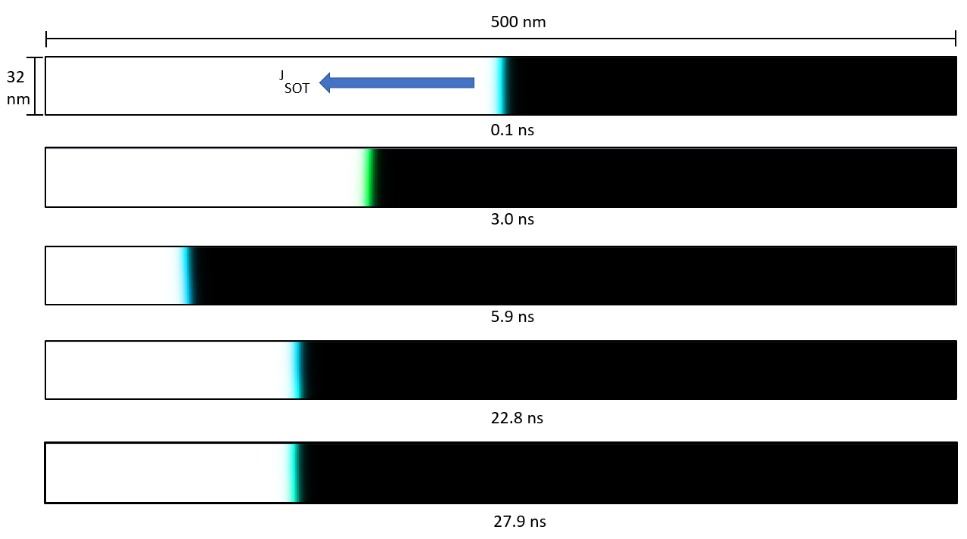
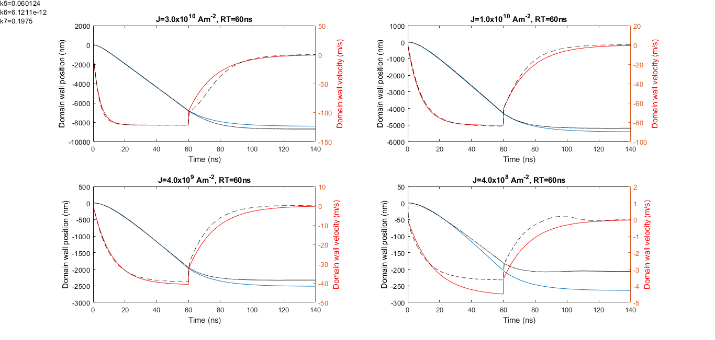
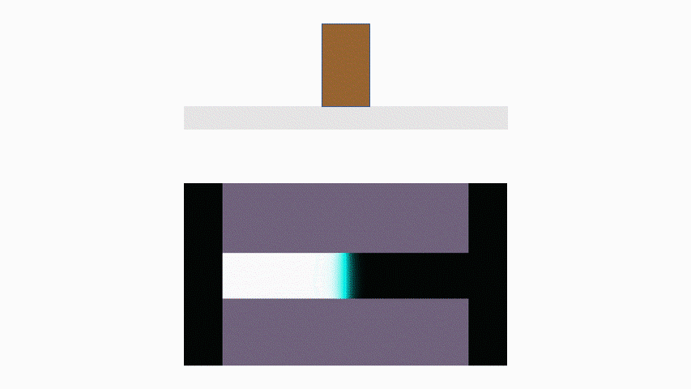
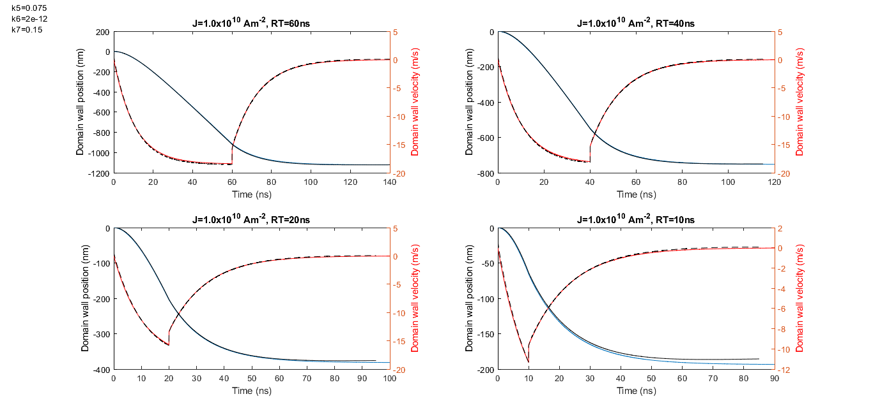
Kinematic Domain Wall Model for Large-Scale Neuromorphic Network Simulation
Kristi Doleh and Leonard M. Humphrey
Electrical Engineering; kxd170004@utdallas.edu & leonard.humphrey@utdallas.edu
Faculty Mentor: Prof. Joseph S. Friedman; Program: Electrical Engineering
2022 Jonsson School UG Research Award Recipient
Erik Jonsson School of Engineering & Computer Science
University of Texas at Dallas
Richardson, Texas 75083-0688, U.S.A.
Research Project Background/Goals:
Research Project Results:
Landau–Lifshitz–Gilbert (LLG)-based micromagnetic simulations for a single Domain Wall Magnetic-Tunnel-Junction (DW-MTJ) device are extremely resource heavy, and other proposed models are too simplistic to account for many observed magnetic effects like inertia. Thus, there does not exist a reasonably accurate model able to simulate even a medium-scale neuromorphic network (NN) designed with DW-MTJs.
Here we propose that classical kinematic phenomena such as inertia and friction are analogous to the physics underlying DW motion, thereby enabling fast, accurate large-scale simulations of DW-MTJ NNs. Our model avoids the time-consuming process of solving the LLG by parameter-fitting kinematic motion-based equations to micromagnetic simulations enabling a speedup of ~100,000x.
We simulated a 500 nm by 32 nm DW track in mumax3 with randomized perpendicular magnetic anisotropy grains and emulated spin orbit torque (SOT)-driven DW motion. We extracted the DW position over time for model fitting.
Research Project Overview:
We present a preliminary model comprising a second order differential equation solved utilizing Euler’s method, which is amenable for low-resource SPICE modeling. Above we provide a graphical representation of the SOT current and DW position in time juxtaposed against our predictive model demonstrating alignment with simulated dynamics.
Our model determines domain wall motion by iterating over discrete differential equations with a small-time step. Currently, four of the seven model constants can be determined from the simulation results. Given a set of parameters, the relationship between the max velocity and current can be interpolated from the relationships for the corner cases.
Then, a cubic approximation can be applied to this relationship. With the constants c₁ – c₃ from this approximation, and the knowledge that acceleration is 0 when v = v_{max}, the acceleration equation can be simplified to the second equation shown here. This allows k₁ – k₄ to be determined by other constants. As for the other constants, k₅ – k₇ are still currently adjusted manually.
We verify this hypothesis via simulation in mumax3. We simulated a domain wall track across various parameters and currents, so that the model is applicable for a large parameter space. For the parameters analyzed, we’ve determined a minimum and maximum value that the model can operate between. The simulations are run using combinations of these extreme parameter values, with the exception of current density, which is run for a larger range of values.
From these simulations, the domain wall is extracted by identifying the location of maximum magnetization change in the track. This position is analyzed to extract model parameters, such as the maximum value that the velocity reaches for a given current and parameter set. For given parameters, the model then uses these values and their relationship with current density to determine the model constants, which allows the model to be run for arbitrary currents.
Project Conclusions/Outcomes:
Domain motion can be accurately modeled using ordinary second-order differential equations emulating classical mechanics.
We have been able model domain wall behavior over a range of parameter corners and current pulses.
Next steps include evaluating the model on a larger dataset and improving accuracy for finding model constants k₅-k₇.
Notes:
1

