Slide 1
Introduction to exploitation
James McFadyen

Slide 2
About Me
Information Security Engineer and Director of Customer Support at HAWK Network Defense, Inc.
Student at UTD
Active in local security community
2600
UTDCSG
DC214
Experience with penetration testing, big data security, security software development, reverse engineering, exploit development, web application exploitation and development

Slide 3
Introduction to Exploitation
Introduce different types of vulnerabilities
Introduce some assembly and low level concepts
Show vulnerable functions and code, along with fixes
Main focus will be stack overflow exploit development and mitigation bypass techniques

Slide 4
Outline
What is an exploit?
Helpful tools
Vulnerabilities Overview
Stack Overflows
Stack Overflow Exploit Development
Protection mechanisms and how to bypass them

Slide 5
What is an exploit?
“An exploit (from the verb to exploit, in the meaning of using something to one’s own advantage) is a piece of software, a chunk of data, or sequence of commands that takes advantage of a bug,glitch or vulnerability in order to cause unintended or unanticipated behaviour to occur on computer software, hardware, or something electronic (usually computerised). Such behavior frequently includes such things as gaining control of a computer system or allowing privilege escalation or a denial-of-service attack.” - Wikipedia

Slide 6
Why Should We Care?
Exploitation can allow an attacker to gain complete control of a system or a network
Can expose sensitive information, such as sensitive customer data, source code, company emails, etc…
Vulnerable software can hurt reputation.. Adobe..
Interruption of business continuity

Slide 7
Helpful Tools
Linux
GDB, gcc, vi, perl/python/ruby, readelf, objdump, ltrace, strace, ropeme, valgrind, metasploit
Windows
WinDBG, OllyDBG, ImmunityDBG, IDA, Python, Mona (ImmunityDBG plugin)

Slide 8
Vulnerabilities
Some vulnerabilities include:
Stack Overflow
Format String
Integer Overflow
Sign Extension
Heap Overflow
Use After Free
Null Pointer Dereference

Slide 9
Stack Overflow Overview
Stack:
Local variables, function parameters..
Grows downward
General case:
Give the program too much input and hijack the instruction pointer (EIP / RIP)
Control instruction pointer
Remotely or locally execute arbitrary code
Don’t necessarily need to control instruction pointer – other registers can be abused

Slide 10
Format String Overview
User supplied variable for printf(), or other output function that uses format flags.
int printf(const char *format, ...); int fprintf(FILE *stream, const char *format, ...); int sprintf(char *str, const char *format, ...); int snprintf(char *str, size_t size, const char *format, ...);
printf(“Hello, %s”, name); // This is ok
printf(name); // BAD
The user can specify the format flags!

Slide 11
Integer Overflow Overview
“An integer overflow condition exists when an integer, which has not been properly sanity checked, is used in the determination of an offset or size for memory allocation, copying, concatenation, or similarly. If the integer in question is incremented past the maximum possible value, it may wrap to become a very small, or negative number, therefore providing a very incorrect value.” – owasp.org
Not isolated to “integers”, can be any primitive data type

Slide 12
Integer Overflow
If we have an unsigned 8-bit integer, the max value is 255
11111111₂ = 255₁₀
unsigned char z;
z = 255;
z++;
Wraps to 0.
Useful for bypassing certain conditions, allocating too much / too little memory, etc…

Slide 13
Registers
Register | Description
EIP – Instruction Pointer * | Next instruction to be executed
ESP – extended stack pointer | Top of stack
EBP – extended base pointer | Bottom of stack
EAX | Accumulator register
EBX | Base register
ECX | Counter register
EDX | Data register
ESI | Source index
EDI | Destination Index
Note: these are x86 32-bit registers

Slide 14
Stack Overflow
strcpy() doesn't check size
Vulnerable:
char buf[128];
strcpy(buf, userSuppliedString);

Slide 15
Stack Overflow
char *strncpy(char *dest, const char *src, size_t n);
We have a size, but what if..
strncpy(somebuffer, str, strlen(str));
or..
strncpy(somebuffer, str, sizeof(somebuffer));
Where str is supplied by user
Common bug, proper fix:
strncpy(somebuffer, str, sizeof(somebuffer)-1);

Slide 16
Stack Overflow
char *strncat(char *dest, const char *src, size_t n);
Ex:
void vulnerable(char *str1, char *str2)
{
char buf[256];
strncpy(buf, str1, 100);
strncat(buf, str2, sizeof(buf)-1);
}
Fix: strncat(buf, str2, sizeof(buf) - strlen(buf) -1);

Slide 17
Stack Overflow
The stack:
Low memory addresses
ESP
local variables
...
EBP - x
EBP
EBP
RET
EBP + x
arguments...
previous stack frame
High memory addresses

Slide 18
Stack Overflow
ESP
char buf[100]
100 byte buffer
EBP
EBP
4 bytes
4 bytes
RET
4 bytes
argc
*argv[]

Slide 19
Stack Overflow
Assume user passes input to buf as an argument
Example input:
$ ./program $(python -c 'print "A" * 108 ')

Slide 20
Stack Overflow
ESP
RET overwritten
108 bytes
( 0x41 * 108)
char buf[100]
100 byte buffer
EBP
EBP
4 bytes
4 bytes
RET
4 bytes
argc
*argv[]

Slide 21
Stack Overflow
In previous slide, ret is overwritten.
When this value is popped off the stack, EIP will point to 0x41414141, which is not a valid instruction.
Now, to control EIP, subtract 4 and put a new memory address.
Example Input:
: $ ./program $(python -c 'print "A" * 104 + “\xef\xbe\xad\xde”')
The above memory address is fake

Slide 22
Stack Overflow
ESP
0xdeadbeef
108 bytes
( 0x41 * 108)
char buf[100]
100 byte buffer
EBP
EBP
4 bytes
4 bytes
RET
4 bytes
argc
*argv[]

Slide 23
Stack Overflow
$ ./program $(python -c 'print "A" * 104 + “\xef\xbe\xad\xde” ')
We have 104 bytes for a payload
Payload can be anything, but for our purpose we would spawn a shell
The payload will be fixed size, so when we insert it, we must reduce the # of A's by the size of the payload

Slide 24
Stack Overflow
$ ./program $(python -c 'print "A" * 104 + “\xef\xbe\xad\xde” ')
If we had a 32 byte payload .. (real payload will not be a bunch of \xff)
$ ./program $(python -c 'print "A" * 72 + “\xff\xff\xff\xff\xff\xff\xff\xff\xff\xff\xff\xff\xff\xff\xff\xff\xff\xff\xff\xff\xff\xff\xff\xff\xff\xff\xff\xff\xff\xff\xff\xff” + “\xef\xbe\xad\xde” ')
We have adjusted the buffer so the payload will fit
We will then have to point EIP (\xef\xbe\xad\xde) to our payload on the stack

Slide 25
Stack Overflow
$ ./program $(python -c 'print "A" * 72 + “\xff\xff\xff\xff\xff\xff\xff\xff\xff\xff\xff\xff\xff\xff\xff\xff\xff\xff\xff\xff\xff\xff\xff\xff\xff\xff\xff\xff\xff\xff\xff\xff” + “\xef\xbe\xad\xde” ')
“\xef\xbe\xad\xde” would be replaced with the address of our payload
EIP will now point to the address of our payload, which will spawn a shell
Not very effective... why?

Slide 26
Protection Mechanisms (Windows)
DEP – Data execution Prevention
Can't execute on the stack
/GS Flag – cookie / canary
detects if stack has been altered
SafeSEH – Structured Exception Handler
Try / except, catches exceptions
ASLR - Address Space Layout Randomization
Randomizes addresses in memory

Slide 27
Protection Mechanisms (Linux)
NX – Stack Execute Invalidation
Processor feature
Like DEP, can't execute on the stack
Stack Smashing Protection – cookie / canary
Generally enabled by default
ASLR - Address Space Layout Randomization
Many other compiler protections...

Slide 28
ret2libc (Linux)
Return to library
If we point EIP to a function in libc, such as system(), we can pass it our own arguments
EIP will point to address of system(), next 4 bytes return address, next 4 bytes will be arguments
Example:
Overwrite EIP with address of system. Call this offset “x”
At offset x+4, (right after EIP), we have a return address
At x+8, we have the arguments. “/bin/sh” would make great arguments..
./program $(python -c 'print "A" * 104 + address_of_system + return_address + payload ')
Above assumes ‘program’ to be vulnerable, and the necessary offset is 104
system(“bin/sh”) would spawn a shell

Slide 29
Return Chaining
This is very useful, can use it in conjunction with the ret2libc methodology to bypass more protection mechanisms, such as ASCII Armoring
If we try the ret2libc technique on a binary with ASCII Armor, we see that there are null bytes in the address. Ex: 0x00167100
To evade this protection, we must repeatedly return into the PLT, in a “chain” of instructions

Slide 30
Return Chaining
The PLT (Procedure Linkage Table) and the GOT (Global Offset Table) are two important sections
When a program calls a function, it calls a function “stub” in the PLT, which then jumps to an address listed in the GOT.
On first call to the GOT from PLT, the address for the wanted function will be resolved by dynamic linker and patched into the GOT.
Next time the PLT entry jumps to the GOT, it will jump to the actual address.

Slide 31
Return Chaining
If we have a libc function that has null bytes, we can take advantage of the PLT and GOT to achieve the same goal as ret2libc
char *strcpy(char *dest, const char *src);
*dest will be address of GOT for a function
*src will be the bytes
We have to do this byte at a time…
How do we do this?

Slide 32
Return Chaining
Repeatedly call strcpy, write a single byte into GOT for a function that gets called in the program
Example: replace printf() with system()
Since there are null bytes in system, we write one byte at a time of the 4 byte address , null bytes included
This changes printf() to system(), so when we call printf() in the program, it actually calls system (since system() probably won’t already exist in the binary)
So what does that look like?

Slide 33
Return Chaining
Basic example: pseudo-payload to overwrite GOT of printf() with system():
strcpy() + pop pop ret + printf@GOT[0] + 1st byte of system() address
strcpy() + pop pop ret + printf@GOT[1] + 2nd byte of system() address
strcpy() + pop pop ret + printf@GOT[2] + 3rd byte of system() address
strcpy() + pop pop ret + printf@GOT[3] + 4th byte of system() address
Once this is accomplished, carry out ret2libc like normal, but instead of executing system(), we point to printf(), since it is overwritten

Slide 34
Return Chaining
pop pop ret is an important gadget (Explained later)
In an actual payload, it will be a memory address pointing to those instructions
The next 4 bytes after strcpy() are the return address
Since the return address has pop pop ret, it will execute those instructions, moving past the arguments to strcpy(): dst and src.

Slide 35
ROP Basics
Return Oriented Programming
This is not an introduction to x86 assembly
Uses code that is already in the program’s address space
No injection of a payload necessary
Evades DEP / NX
Many techniques exist to bypass even more protection mechanisms
Based on return to library attacks, such as ret2libc

Slide 36
ROP Basics
Evolution:
Ret2libc, “Borrowed Code Chunks”, ROP
Extends beyond scope of ret2lib techniques by allowing the use of “gadgets”
Allows loops and conditional branching
Take control of stack
Especially interested in $esp / $rsp
We will rely on the stack pointer rather than instruction pointer for ROP
Take sequences of instructions that already exist in the code to control the program

Slide 37
ROP Basics
Usefool tools (Linux):
Scripting language of choice
gdb
objdump
readelf
ROPGadget http://shell-storm.org/project/ROPgadget/
ROPEme

Slide 38
ESP vs. EIP (RSP vs. RIP)
EIP points to the current instruction to execute
Processor automatically increments EIP upon execution
ESP does not get incremented by the processor
“ret” increments ESP
Note: not limited to ret for stack traversal

Slide 39
Gadgets
We will only introduce very basic and limited gadgets, since they are beyond the scope of this presentation.
Different instruction sequences ending in “ret”
They perform specific tasks, such as moving the stack pointer or writing a value
Ex: pop eax; ret
Load address at stack pointer into eax
Ex: pop eax; pop ebx; ret
Load two consecutive words into eax and ebx.
Also good for “stepping over” instructions and incrementing the stack pointer
Need to understand assembly, these can get very complicated when dealing with logic and control flow

Slide 40
Gadgets
We can use gadgets to pivot the stack into an area that we control
Ex: mov esp, ebx; ret
Strings of these gadgets form chains of instructions
Gadgets placed in specific orders can execute specific tasks
Only requirement is a sequence of useable bytes somewhere in executable memory region

Slide 41
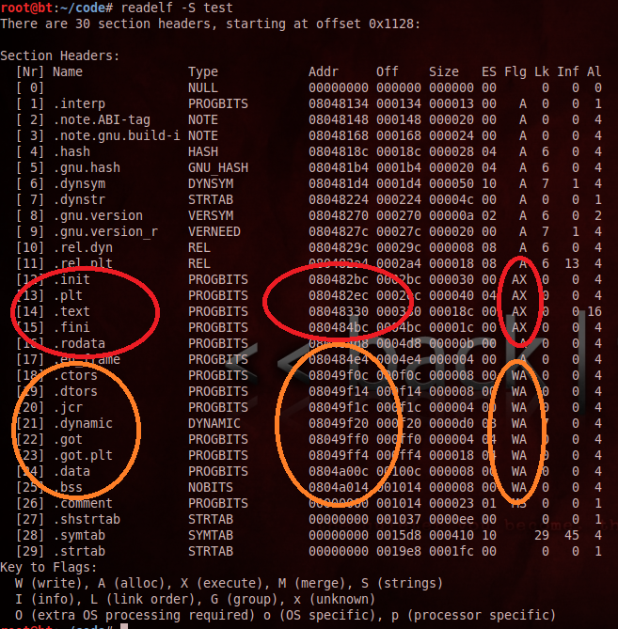
red – executable
Orange - writeable

Slide 42
Gadgets
“readelf –s binary” – displays section headers for binary
Areas such as .bss are writeable - this allows us to throw payloads here, create custom stacks, etc…
.got is also an important place to write, since we can manipulate a program by changing the functions
Ex: replace a printf() with exec() in a binary that does not contain exec()

Slide 43
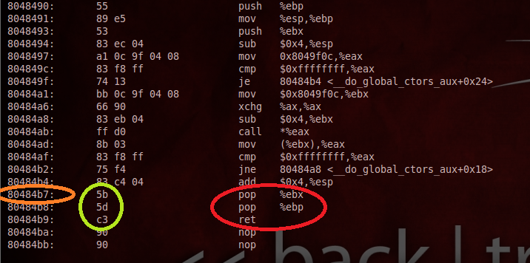
Gadgets
Sample objdump output from a Linux binary

Slide 44
Gadgets
Orange: memory location
Green: opcodes
Red: instructions
You can see the gadgets can be obtained from within the same binary
But do we really want to dig through objdump output?

Slide 45
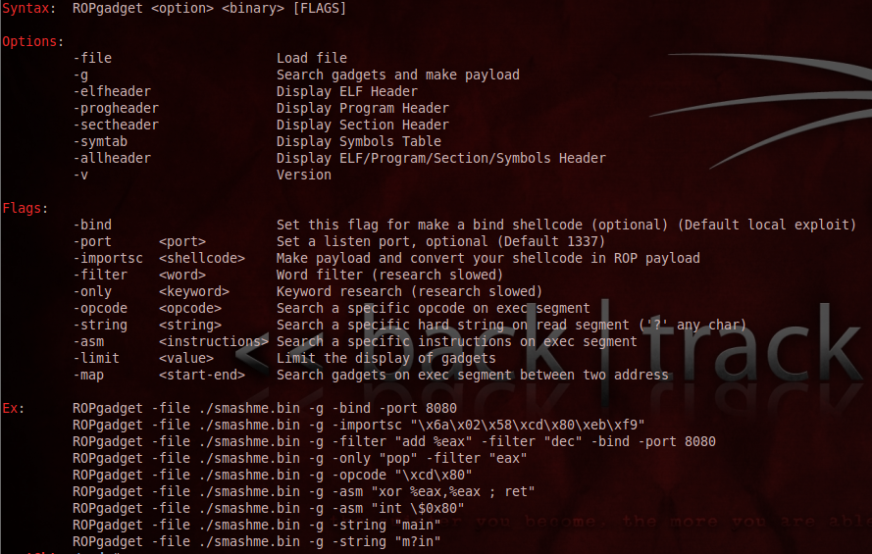

Slide 46
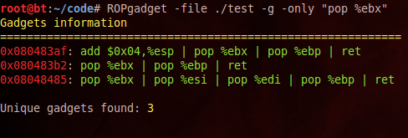
Gadgets
Example: Assume we control the stack, and we need to place a value from our stack into EBX..
If we execute memory address 0x080483b2, it will pop our value from the stack pointer, store it in EBX, which increments the stack pointer, pop the next value into EBP, which increment thes stack pointer, and return, which increments the stack pointer.

Slide 47
References
“Source Code Auditing” - Jared Demott
“Smashing the stack in 2010” - Andrea Cugliari + Mariano Graziano
A Gentle Introduction to Return-Oriented Programming by Tim Kornau - http://blog.zynamics.com/2010/03/12/a-gentle-introduction-to-return-oriented-programming/
PLT and GOT – The key to code sharing and dynamic libraries - http://www.technovelty.org/linux/pltgot.html
“Return-oriented Programming: Exploits Without Code Injection” Erik Buchanan, Ryan Roemer… http://cseweb.ucsd.edu/~hovav/talks/blackhat08.html

Slide 48
References
“Payload Already Inside: Data Reuse for ROP Exploits” Blackhat 2010, longld @ vnsecurity.net - http://media.blackhat.com/bh-us-10/whitepapers/Le/BlackHat-USA-2010-Le-Paper-Payload-already-inside-data-reuse-for-ROP-exploits-wp.pdf
“Practical Return-Oriented Programming” Dino A. Dai Zovi - http://trailofbits.files.wordpress.com/2010/04/practical-rop.pdf
“ Linux exploit development part 4 – ASCII armor bypass + return-to-plt” – sickn3ss

